Slide 1




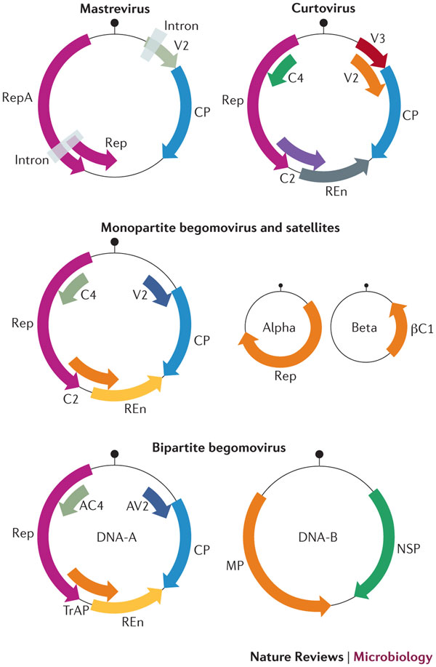
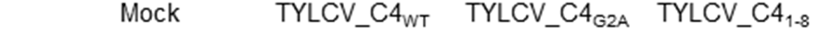
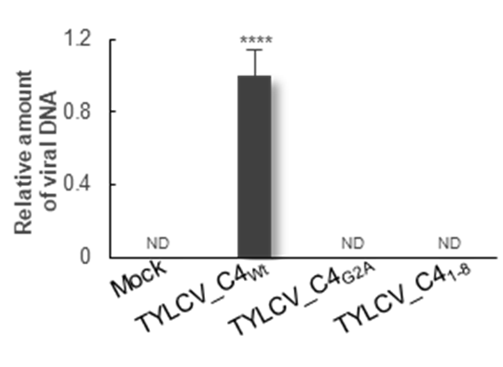
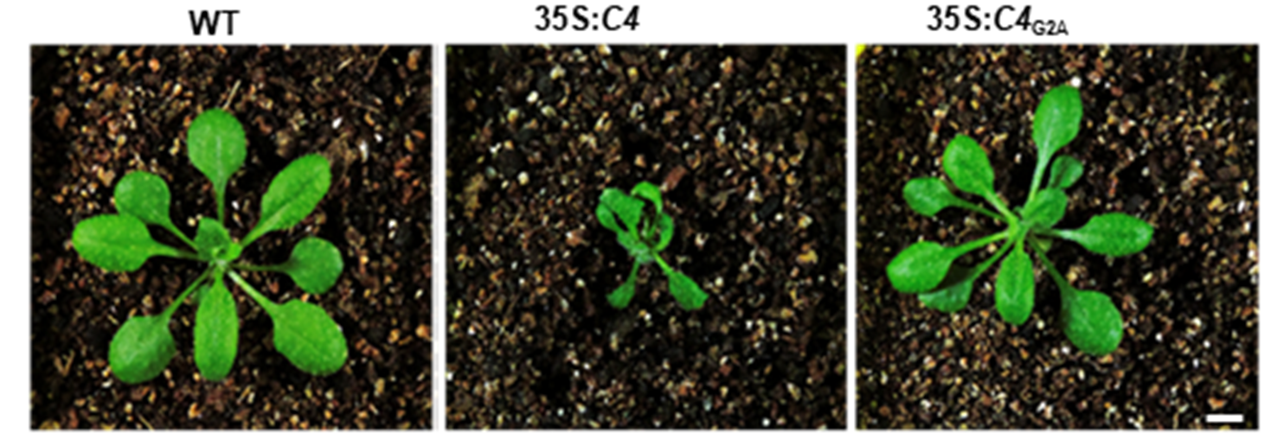
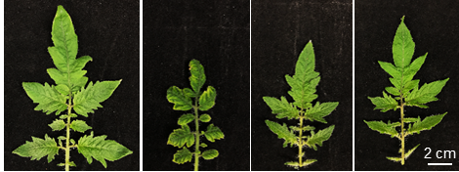
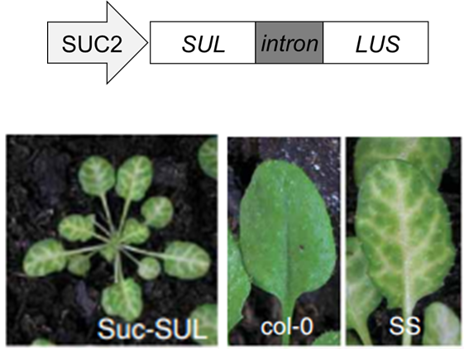
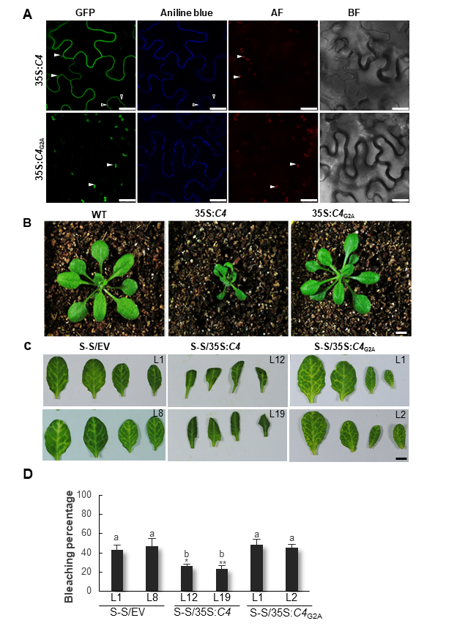
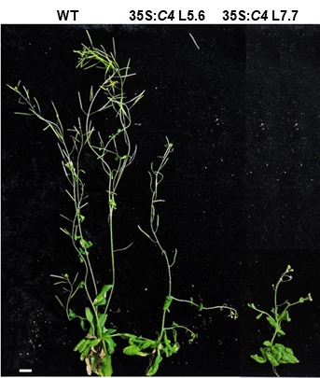
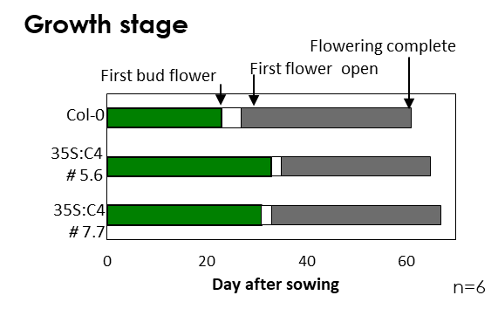
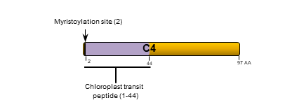
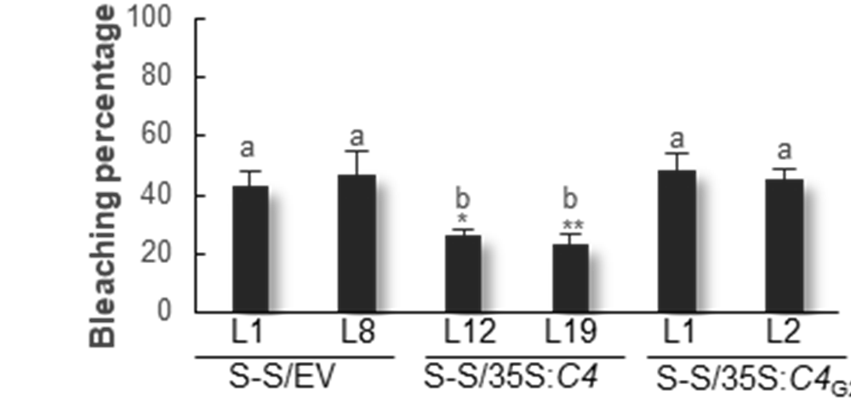
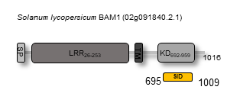
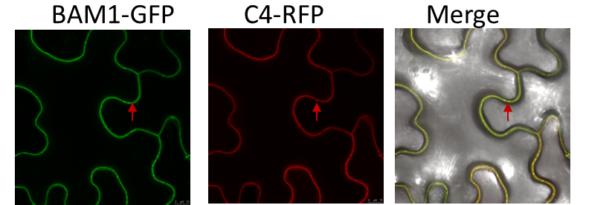
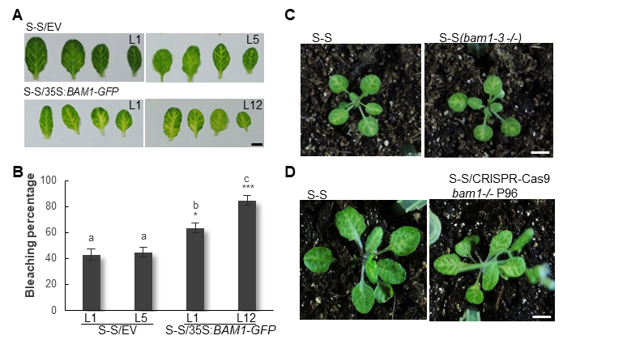
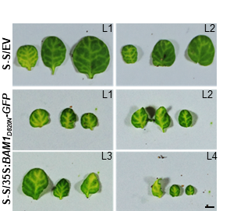
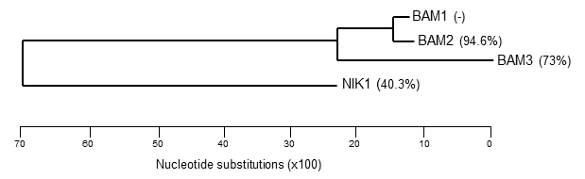
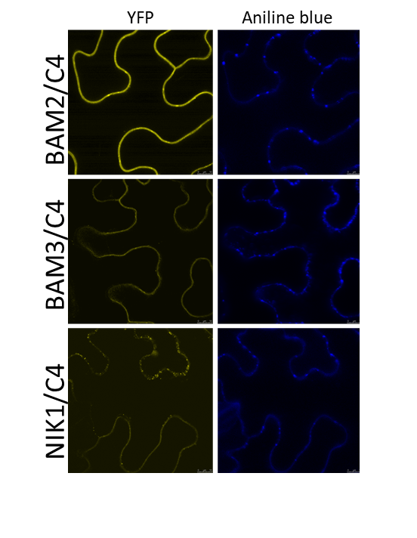
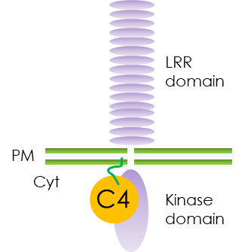
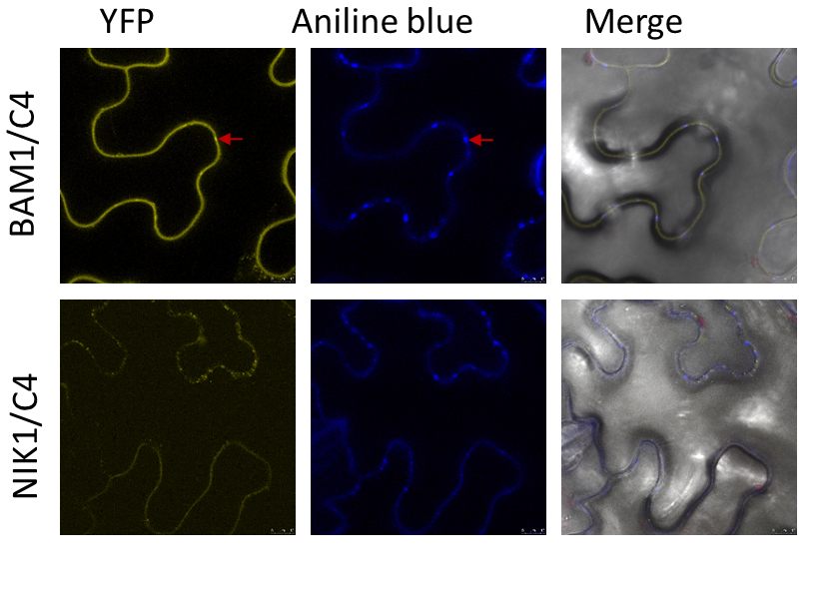
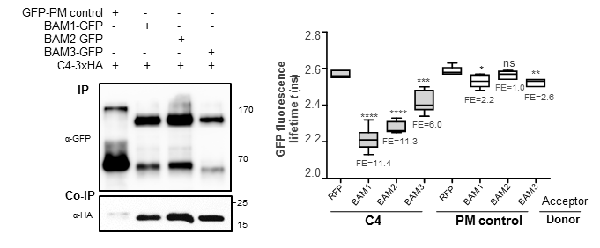
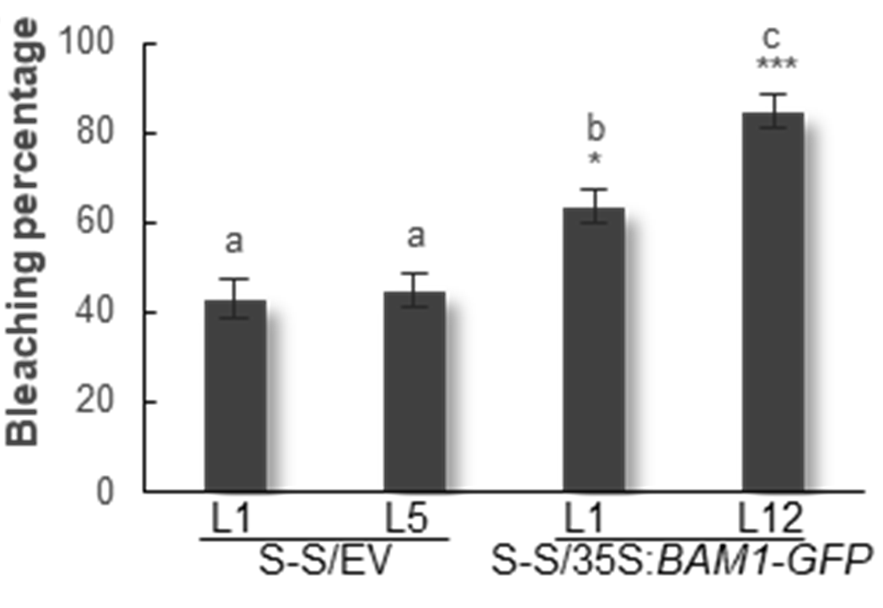
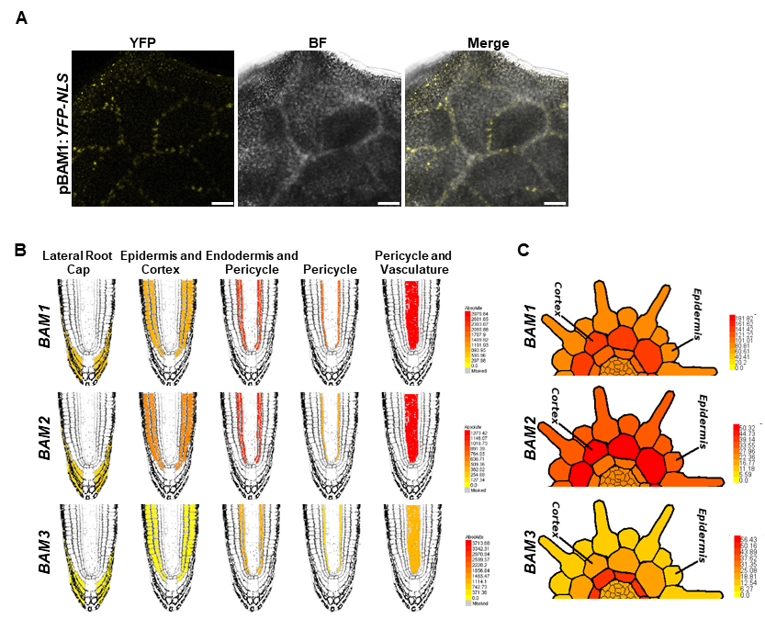
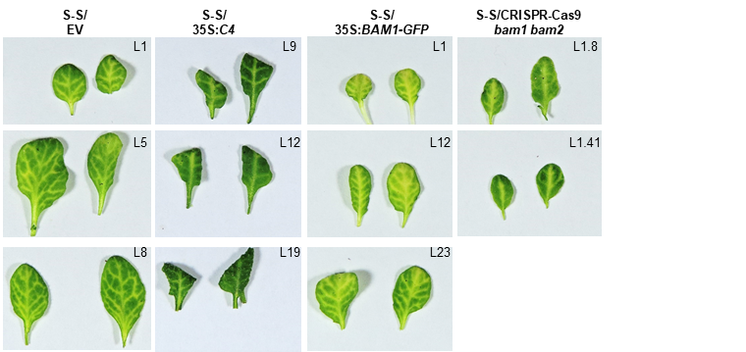
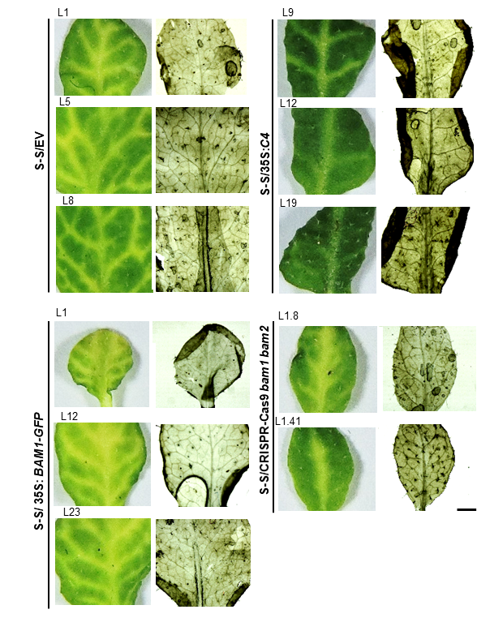
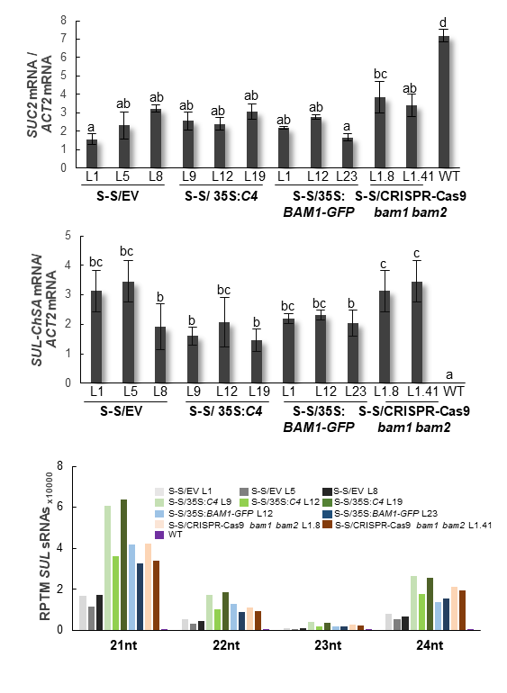
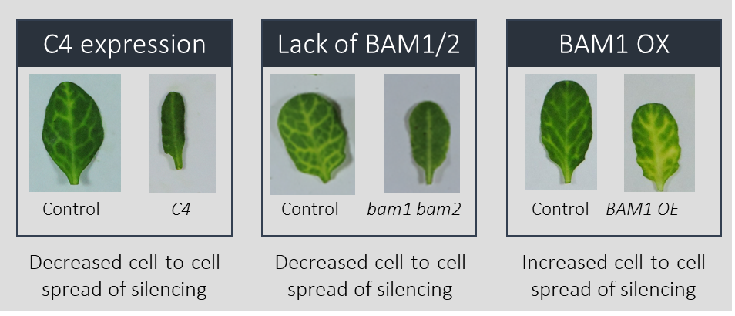
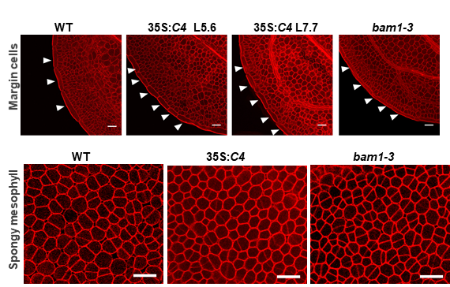
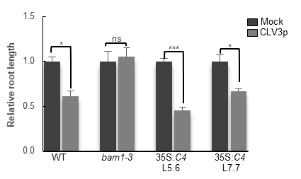
A virus-targeted plant receptor-like kinase promotes cell-to-cell spread of RNAi
Tabata Rosas-Diaz^{a,h}, Dan Zhang^{a,b}, Pengfei Fan^{a,b}, Liping Wang^{a,b}, Xue Ding^{a,b}, Yuli Jiang^{a,b}, Tamara Jimenez-Gongora^{a,b}, Laura Medina-Pucheª, Xinyan Zhao^{a,b}, Zhengyan Feng^{a,b}, Guiping Zhang^{a,b}, Xiaokun Liu^{c}, Eduardo R Bejarano^{d}, Li Tanª, Heng Zhangª, Jian-Kang Zhu^{a,e}, Weiman Xingª, Christine Faulkner^{c,f}, Shingo Nagawaª, Rosa Lozano-Duran^{a,f}
Author affiliation: ªShanghai Center for Plant Stress Biology, Chinese Academy of Sciences, Shanghai 201602, China; Center for Excellence in Molecular Plant Science, Chinese Academy of Sciences. ^{b}University of the Chinese Academy of Sciences, Beijing 100049, China. ^{c}John Innes Centre, Norwich, United Kingdom. ^{d}Instituto de Hortofruticultura Subtropical y Mediterránea “La Mayora” (IHSM-UMA-CSIC), Area de Genética, Facultad de Ciencias, Universidad de Málaga, Campus de Teatinos s/n, E-29071 Málaga, Spain. ^{e}Department of Horticulture and Landscape Architecture, Purdue University, West Lafayette, 47907, IN, USA. ^{f}CAS-JIC Centre of Excellence for Plant and Microbial Science (CEPAMS), Shanghai Institutes for Biological Sciences, Chinese Academy of Sciences (CAS), Shanghai 200032, China. ^{h}Present addrres:Instituto de Hortofruticultura Subtropical y Mediterránea “La Mayora” (IHSM-UMA-CSIC), Area de Genética, Facultad de Ciencias, Universidad de Málaga, Campus de Teatinos s/n, E-29071 Málaga, Spain
Abstract
RNA interference (RNAi) in plants can move from cell to cell, allowing for systemic spread of an anti-viral immune response. How this cell-to-cell spread of silencing is regulated is currently unknown. Here, we describe that the C4 protein from Tomato yellow leaf curl virus can inhibit the intercellular spread of RNAi. Using this viral protein as a probe, we have identified the receptor-like kinase (RLK) BARELY ANY MERISTEM 1 (BAM1) as a positive regulator of the cell-to-cell movement of RNAi, and determined that BAM1 and its closest homologue, BAM2, play a redundant role in this process. C4 interacts with the intracellular domain of BAM1 and BAM2 at the plasma membrane and plasmodesmata, the cytoplasmic connections between plant cells, interfering with the function of these RLKs in the cell-to-cell spread of RNAi. Our results identify BAM1 as an element required for the cell-to-cell spread of RNAi and highlight that signalling components have been co-opted to play multiple functions in plants.
C4 from TYLCV is a plasma membrane/plasmodesmal protein and suppresses cell-to-cell spread of RNAi
SUC-SUL silencing reporter system (S-S)
TYLCV
2. A mutant TYLCV in C4 protein displays severely compromised infectivity in tomato
1. Genomic organization of Tomato yellow leaf curl virus (TYLCV) and localization motifs in its C4 protein.
4. C4, expressed in Arabidopsis, causes strong developmental alterations, which also requires myristoylation.
5. Expression of wild type C4, but not of the non-myristoylable mutant C4_{G2A}, greatly diminishes the spread of the silencing phenotype, suggesting that PM/PD-localized C4 may interfere with the cell-to-cell movement of silencing from the vasculature.
3. C4 localizes to different compartments in the plant cell, mainly the plasma membrane, plasmodesmata and chloroplasts. Empty arrowheads indicate plasmodesmata; filled arrowheads indicate chloroplasts.
BAM1 promotes the cell-to-cell spread of RNAi
C4 from TYLCV interacts with the receptor kinase BAM1
BAM1 has two homologues
6. The interaction between C4 and the receptor-like kinase (RLK) BARELY ANY MERISTEM 1 (BAM1) occurs through the kinase domain of BAM1, as shown by mapping of this interaction in yeast. This interaction was confirmed by BiFC, Co-IP, FRET-FLIM, and gel filtration. The signal peptide (SP), leucine-rich repeats (LRR), transmembrane domain (TM), and kinase domain (KD) are shown. Arrowheads indicate plasmodesmata.
7. Overexpression of BAM1 results in an extended spread of silencing from the vasculature, suggesting that BAM1 promotes cell-to-cell movement of the silencing signal. BAM1 kinase, using a kinase-dead mutant, activity does not seem to be required for this function.
8. A mutation in the BAM1 gene alone did not affect the silencing phenotype of the SUC:SUL plants, which suggests functional redundancy.
9. The kinase domains of BAM1 and BAM2 are 94% identical at the protein level, whereas those of BAM1 and BAM3 are 73% identical. Consistent with this, C4 can also interact with BAM2 and, more weakly, with BAM3.
BAM1 and its homologue BAM2 are required for the cell-to-cell spread of RNAi
Conclusions
10. BAM1 is strongly expressed in the vasculature, and its expression pattern overlaps with that of BAM2 in roots.
BAM1 promotes the cell-to-cell spread of RNAi
BAM1 and BAM2 act redundantly
C4 targets BAM1/2 and suppresses their activity
12. C4 impairs a subset of all activities of BAM1. For example, the response to CLV3p is not affected.
This is the first description of an element (BAM1/BAM2) required for the cell-to-cell spread of RNAi.
Our work identifies a novel function of the RLKs BAM1/BAM2 in the cell-to-cell spread of RNAi; however, the underlying molecular mechanism is still elusive.
11. Similar developmental phenotypes in the transgenic Arabidopsis lines expressing C4 and the bam1-3 single or bam1-3 bam2-3 double mutant.
13. Spread of silencing and venation pattern in SUC:SUL lines expressing C4, overexpressing BAM1, or mutated in BAM1 and BAM2.
14. Expression of the endogenous SUC2 gene and the SUC:SUL transgene and accumulation of SUL sRNAs in SUC:SUL transgenic plants expressing C4, overexpressing BAM1, or mutated in BAM1 and BAM2.

