Slide 1
INEQUALITY CHANGES OVER TIME, PRO-POOR GROWTH AND RE-RANKING: LOCAL FOCUS AND GLOBAL ASSESSMENT.
XXI Encuentro de Economía Pública. Gerona 2014
Elena Bárcena Martín;
Luis José Imedio Olmedo;
Encarnación M. Parrado Gallardo
Universidad de Málaga

Slide 2
Introduction
In the literature there are proposals of indices of distributional change that may in fact be considered as indices measuring the degree of income mobility.
Based on entropy measures (Cowell, 1985)
Based on the Gini index (Silber, 1995)
Based on the generalized Gini class of indices (Jenkins and Van Kerm , 2006; Silber and Weber, 2008)

Slide 3
Introduction
Analysis of inequality changes over time does not provide information about the situation of especific individuals mobility?
A change in inequality can mask different sittuations affecting different parts of the distribution local focus vs. Global assesment

Slide 4
Introduction
We propose the decomposition of a wider family of inequality measures (Imedio et al. 2013) that contains as particular cases the generalized Gini class of indices, the indices of Aaberge (2000) and the Bonferroni index, into two components:
one summarizing mobility in the form of reranking and
one summarizing progressivity in income growth (pro-poor rather than pro-rich)
Then we analyze the change in overall inequality taking into account the different situations that take place along the income distribution to reveal the extent to which each part of the income distribution contributes to the global measure of inequality, reranking and pro-poor growth. (We make use of the results in Imedio et al. 2013)

Slide 5
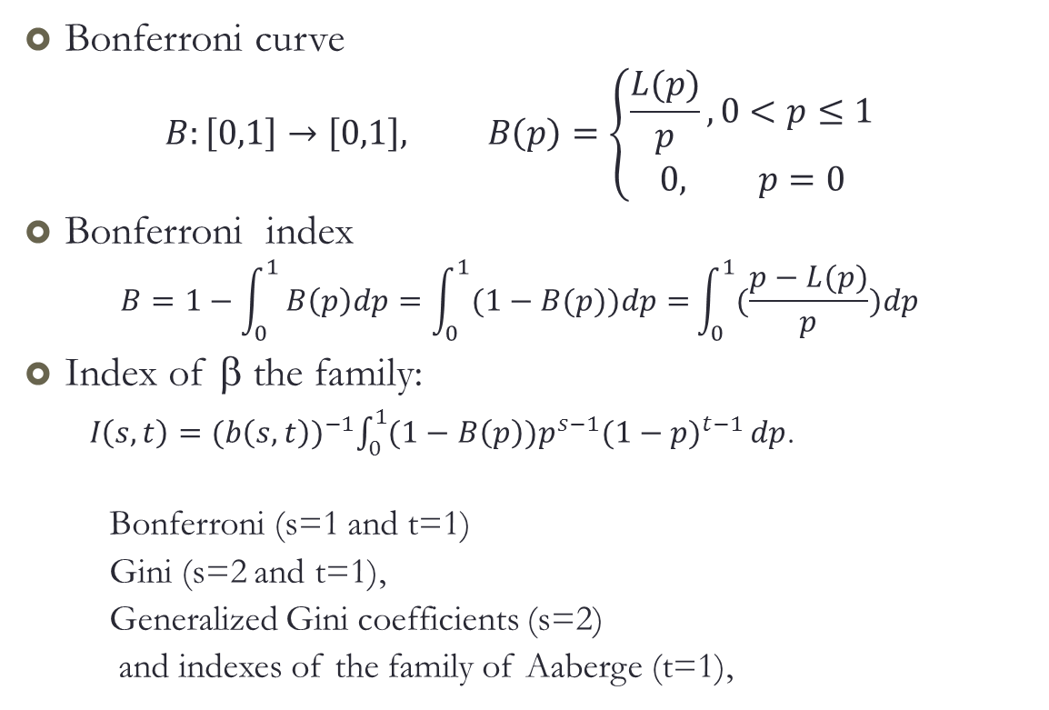
Measuring inequality: the β class of inequality measures
Bonferroni curve
$$B:\left[0,1\right]→\left[0,1\right], B\left(p\right)=\left\{\begin{aligned}\frac{L(p)}{p}, 0<p≤1 \\ 0, p=0\end{aligned}\right.$$
Bonferroni index
$$B=1−\int_{0}^{1}{B\left(p\right)dp=\int_{0}^{1}{(1−B(p))dp}=}\int_{0}^{1}{(\frac{p−L(p)}{p})dp}$$
Index of β the family:
$I\left(s,t\right)={(b\left(s,t\right))}^{−1}\int_{0}^{1}{{(1−B\left(p\right))p}^{s−1}{(1−p)}^{t−1}}dp$.
Bonferroni (s=1 and t=1)
Gini (s=2 and t=1),
Generalized Gini coefficients (s=2)
and indexes of the family of Aaberge (t=1),
Weights
Not necesarily monotonous

Slide 6
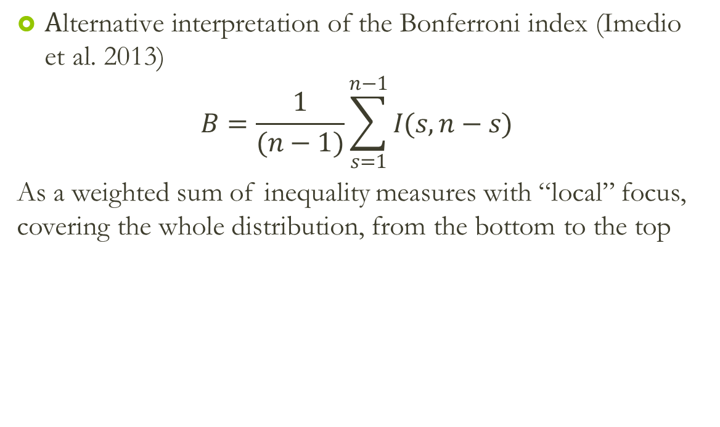
Measuring inequality: the β class of inequality measures
$\text{A}\text{lternative} \text{interpretation} \text{of} \text{the} \text{Bonferroni} \text{index}\text{ (}\text{Imedio} \text{et} \text{al}\text{. 2013)}$
$$B=\frac{1}{(n−1)}\sum_{s=1}^{n−1}{I(s,n−s)}$$
As a weighted sum of inequality measures with “local” focus, covering the whole distribution, from the bottom to the top

Slide 7
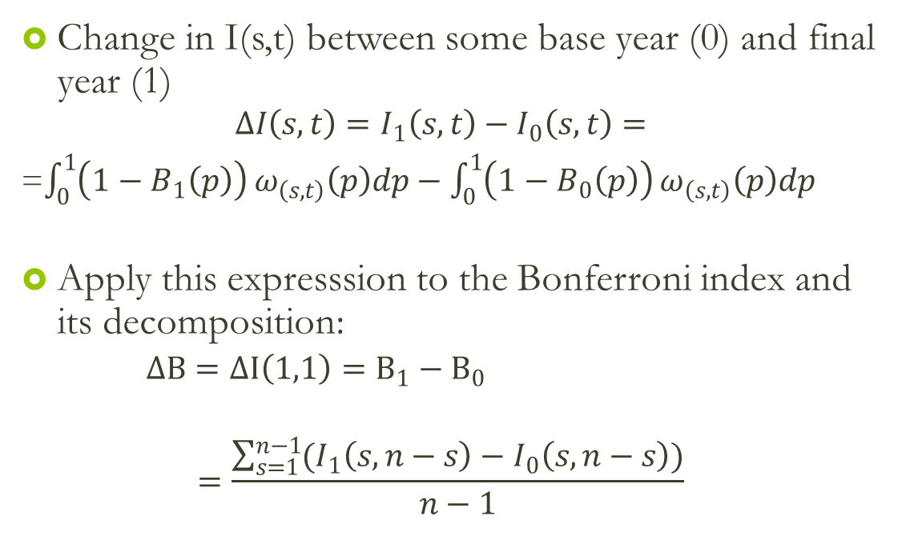
Inequality change
Change in I(s,t) between some base year (0) and final year (1)
$$∆I\left(s,t\right)=I_{1}\left(s,t\right)−I_{0}\left(s,t\right)=$$
=$\int_{0}^{1}{\left(1−B_{1}\left(p\right)\right)}ω_{\left(s,t\right)}\left(p\right)dp−\int_{0}^{1}{\left(1−B_{0}\left(p\right)\right)}ω_{\left(s,t\right)}\left(p\right)dp$
Apply this expresssion to the Bonferroni index and its decomposition:
$∆B=∆I\left(1,1\right)=B_{1}−B_{0}$
$$=\frac{\sum_{s=1}^{n−1}{(I_{1}\left(s, n−s\right)}−I_{0}\left(s, n−s\right))}{n−1}$$
roughly estimate the contribution of each “local” measure to the global change in inequality

Slide 8
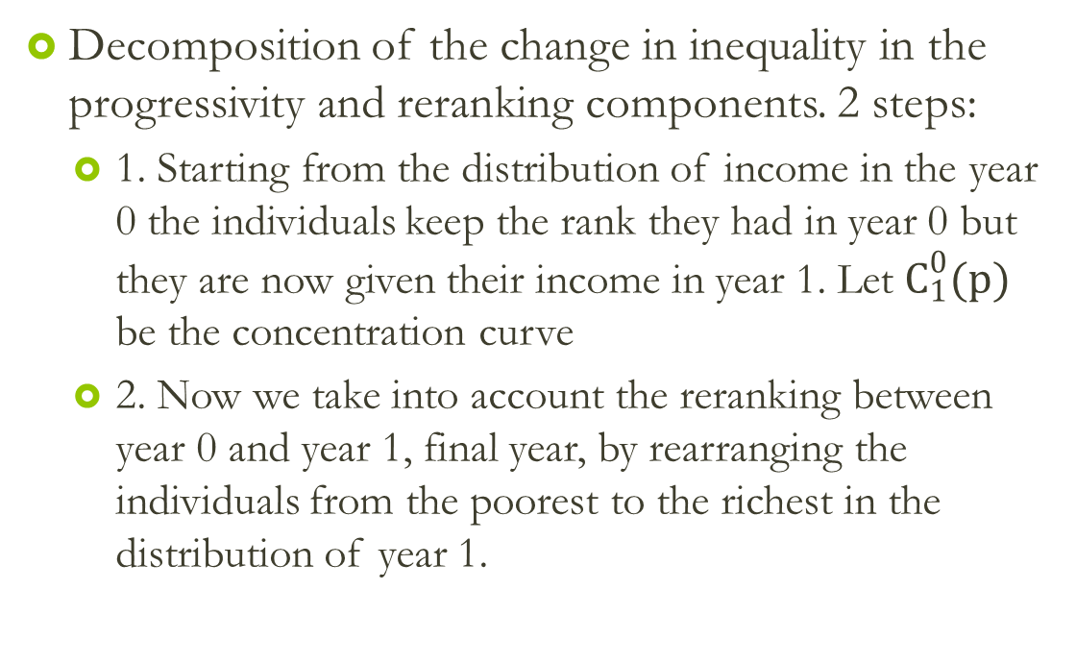
Inequality change
Decomposition of the change in inequality in the progressivity and reranking components. 2 steps:
1. Starting from the distribution of income in the year 0 the individuals keep the rank they had in year 0 but they are now given their income in year 1. Let $C_{1}^{0}(p)$ be the concentration curve
2. Now we take into account the reranking between year 0 and year 1, final year, by rearranging the individuals from the poorest to the richest in the distribution of year 1.

Slide 9
Inequality change

Slide 10
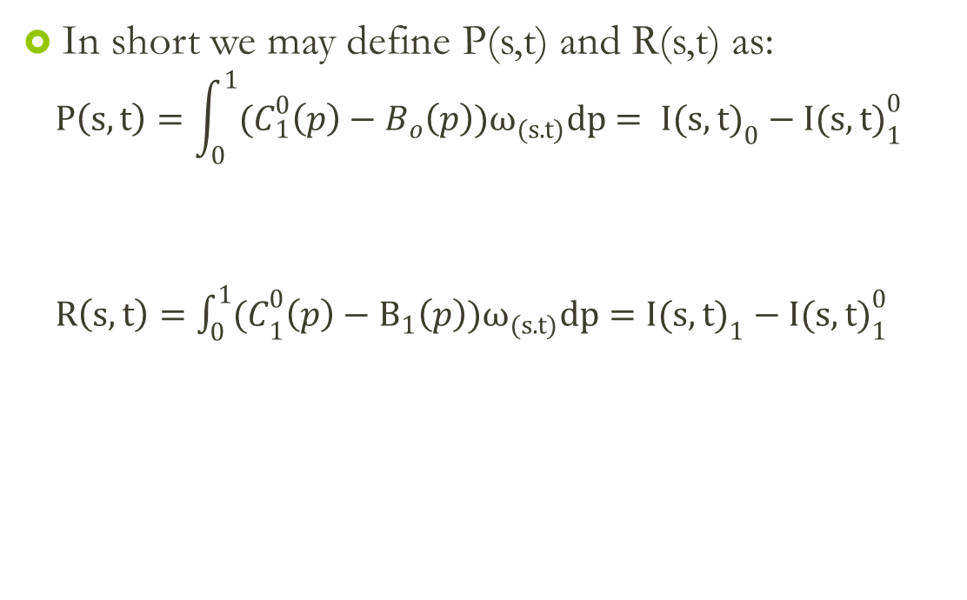
Inequality change
In short we may define P(s,t) and R(s,t) as:
$$P\left(s,t\right)=\int_{0}^{1}{(C_{1}^{0}\left(p\right)−B_{o}\left(p\right))ω_{(s.t)}dp}= {I(s,t)}_{0}^{}−{I(s,t)}_{1}^{0}$$
$R\left(s,t\right)=\int_{0}^{1}{{(C}_{1}^{0}\left(p\right)−B_{1}\left(p\right))ω_{(s.t)}dp={I(s,t)}_{1}−{I(s,t)}_{1}^{0}}$
It summarizes the progressivity or pro-poor income growth across the base year income distribution
It summarizes the reranking from the initial to the final year.

Slide 11

Inequality change
Proposition 2. The change in inequality measured through inequality measure belonging to the β family can be decomposed in two terms, progressivity and reranking, (for s=2, it is the Jenkins and Van kerm, 2006, expression):
$$∆I\left(s,t\right)=R\left(s,t\right)−P(s,t)$$

Slide 12
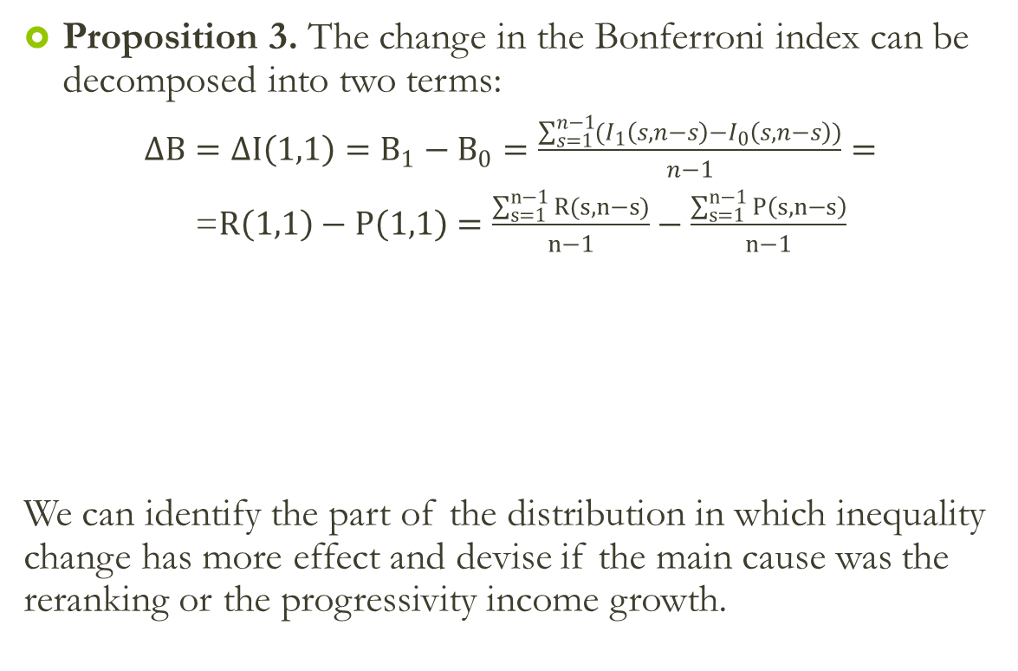
Inequality change
Proposition 3. The change in the Bonferroni index can be decomposed into two terms:
$∆B=∆I\left(1,1\right)=B_{1}−B_{0}=\frac{\sum_{s=1}^{n−1}{(I_{1}\left(s, n−s\right)}−I_{0}\left(s, n−s\right))}{n−1}=$
=$R\left(1,1\right)−P\left(1,1\right)=\frac{\sum_{s=1}^{n−1}{R(s, n−s)}}{n−1}−\frac{\sum_{s=1}^{n−1}{P\left(s, n−s\right)}}{n−1}$
We can identify the part of the distribution in which inequality change has more effect and devise if the main cause was the reranking or the progressivity income growth.
the arithmetic mean of the effect of the reranking when the weights give more importance to different parts of the distribution, from the bottom to the top of the distribution,

Slide 13
Empirical illustration
Source: EU_SILC
11 European countries
Period 2007-2010
two income sources: employee income and self-employment income
Aim: to analyze the different distributive impact of the crisis on them despite the conclusion we can derive from global measures of inequality change.
Those incomes are expressed in constant prices of 2005.
Trimming: top 1%₀ and the bottom 1%₀ excluded.
Sample: 13,737 individuals for the employee income and 2,278 individuals for self-employment income.
Weights: longitudinal weights

Slide 14
Empirical illustration
Table 2. Changes in income inequality of employee incomes measured through the Bonferroni index. Reranking and Progressivity.
Country | B₂₀₀₇ | B₂₀₁₀ | B₂₀₁₀- B₂₀₀₇ | Reranking | Progresivity
AT | 545 | 502 | -43 | 158 | 201
BE | 415 | 395 | -19 | 87 | 107
DK | 512 | 500 | -12 | 123 | 135
ES | 453 | 462 | 8 | 142 | 134
FI | 538 | 529 | -9 | 130 | 139
IT | 435 | 473 | 38 | 108 | 70
LU | 515 | 509 | -6 | 75 | 81
NL | 566 | 543 | -24 | 82 | 106
NO | 523 | 520 | -3 | 130 | 132
PT | 471 | 496 | 25 | 124 | 99
UK | 523 | 532 | 9 | 153 | 144
Pro-poor changes in income

Slide 15
Empirical illustration
Table 3. Changes in income inequality of self-empoyment incomes measured through the Bonferroni index. Reranking and Progressivity.
Country | B₂₀₀₇ | B₂₀₁₀ | B₂₀₁₀- B₂₀₀₇ | Reranking | Progresivity
AT | 658 | 584 | -74 | 197 | 271
BE | 409 | 544 | 135 | 325 | 191
DK | 905 | 891 | -14 | 42 | 56
ES | 482 | 502 | 20 | 313 | 293
FI | 763 | 758 | -5 | 127 | 132
IT | 584 | 586 | 2 | 220 | 218
LU | 629 | 701 | 72 | 140 | 68
NL | 749 | 699 | -50 | 115 | 165
NO | 688 | 683 | -4 | 104 | 108
PT | 597 | 590 | -7 | 258 | 265
UK | 667 | 649 | -18 | 513 | 531
Pro-poor changes in income

Slide 16
Empirical illustration: local focus
employee income
Country |  | Bonferroni | I15 | I24 | I33 | I42 | I51
AT | Change inequality | -43 | -45 | -53 | -47 | -39 | -33
 | Progresivity | 201 | 338 | 263 | 186 | 131 | 89
 | Reranking | 158 | 293 | 210 | 139 | 91 | 56
BE | Change inequality | -19 | -52 | -32 | -13 | -1 | 3
 | Progresivity | 107 | 226 | 151 | 88 | 47 | 21
 | Reranking | 87 | 174 | 118 | 75 | 46 | 24
DK | Change inequality | -12 | -14 | -18 | -16 | -10 | -4
 | Progresivity | 135 | 284 | 180 | 113 | 66 | 33
 | Reranking | 123 | 270 | 162 | 98 | 56 | 30
ES | Change inequality | 8 | 18 | 13 | 7 | 4 | 0
 | Progresivity | 134 | 252 | 172 | 115 | 80 | 50
 | Reranking | 142 | 270 | 185 | 122 | 84 | 50
FI | Change inequality | -9 | -5 | -8 | -11 | -11 | -10
 | Progresivity | 139 | 224 | 190 | 139 | 92 | 49
 | Reranking | 130 | 219 | 181 | 128 | 81 | 39
IT | Change inequality | 38 | 56 | 54 | 41 | 26 | 12
 | Progresivity | 70 | 160 | 88 | 50 | 32 | 21
 | Reranking | 108 | 216 | 143 | 91 | 58 | 33
LU | Change inequality | -6 | 18 | 12 | -6 | -24 | -30
 | Progresivity | 81 | 125 | 87 | 75 | 67 | 52
 | Reranking | 75 | 142 | 99 | 69 | 43 | 22
NL | Change inequality | -24 | -22 | -35 | -31 | -21 | -11
 | Progresivity | 106 | 176 | 147 | 103 | 66 | 38
 | Reranking | 82 | 154 | 112 | 72 | 45 | 27
NO | Change inequality | -3 | 10 | 2 | -6 | -10 | -9
 | Progresivity | 132 | 191 | 185 | 143 | 94 | 51
 | Reranking | 130 | 200 | 187 | 136 | 84 | 41
PT | Change inequality | 25 | 38 | 26 | 21 | 22 | 18
 | Progresivity | 99 | 207 | 140 | 83 | 44 | 19
 | Reranking | 124 | 245 | 167 | 105 | 65 | 37
UK | Change inequality | 9 | -15 | 0 | 13 | 23 | 26
 | Progresivity | 144 | 230 | 177 | 138 | 106 | 68
 | Reranking | 153 | 215 | 176 | 152 | 128 | 94
change in inequality was mostly concentrated in the lower part of the distribution… Exceptions

Slide 17
Empirical illustration: local focus
Figure 4. Reranking in employee income along the distribution.
PT and DK more Reranking in the lower part
UK more Reranking in the upper part

Slide 18
self-employment income
Empirical illustration: local focus
Country |  | Bonferroni | I15 | I24 | I33 | I42 | I51
AT | Change inequality | -74 | -63 | -89 | -88 | -75 | -56
 | Progresivity | 271 | 496 | 320 | 244 | 179 | 116
 | Reranking | 197 | 432 | 231 | 156 | 103 | 60
BE | Change inequality | 135 | 136 | 171 | 156 | 127 | 84
 | Progresivity | 191 | 367 | 241 | 143 | 118 | 83
 | Reranking | 325 | 503 | 412 | 299 | 245 | 168
DK | Change inequality | -14 | 0 | -1 | -4 | -17 | -46
 | Progresivity | 56 | 6 | 14 | 38 | 83 | 137
 | Reranking | 42 | 6 | 13 | 34 | 67 | 91
ES | Change inequality | 20 | -7 | 15 | 25 | 32 | 36
 | Progresivity | 293 | 462 | 360 | 284 | 221 | 136
 | Reranking | 313 | 455 | 375 | 309 | 253 | 173
FI | Change inequality | -5 | -2 | -3 | -2 | -5 | -13
 | Progresivity | 132 | 74 | 129 | 157 | 165 | 134
 | Reranking | 127 | 71 | 126 | 155 | 160 | 121
IT | Change inequality | 2 | 10 | 6 | 0 | -4 | -2
 | Progresivity | 218 | 344 | 269 | 212 | 162 | 100
 | Reranking | 220 | 355 | 275 | 212 | 158 | 99
LU | Change inequality | 72 | 76 | 76 | 78 | 77 | 53
 | Progresivity | 68 | 151 | 87 | 54 | 34 | 15
 | Reranking | 140 | 228 | 164 | 132 | 110 | 68
NL | Change inequality | -50 | -22 | -45 | -63 | -67 | -53
 | Progresivity | 165 | 153 | 205 | 197 | 162 | 108
 | Reranking | 115 | 131 | 159 | 134 | 95 | 56
NO | Change inequality | -4 | 2 | -6 | -8 | -6 | -4
 | Progresivity | 108 | 99 | 117 | 120 | 116 | 88
 | Reranking | 104 | 100 | 112 | 113 | 110 | 84
PT | Change inequality | -7 | 9 | 1 | -12 | -21 | -15
 | Progresivity | 265 | 369 | 326 | 254 | 206 | 173
 | Reranking | 258 | 378 | 327 | 242 | 185 | 158
UK | Change inequality | -18 | -32 | -45 | -36 | -3 | 28
 | Progresivity | 531 | 901 | 643 | 517 | 383 | 212
 | Reranking | 513 | 870 | 598 | 481 | 379 | 239
change in inequality was mostly concentrated in the upper part of the distribution… Exceptions
Progresivity and reranking concentrated in the lower part of the distribution… Exceptions

Slide 19
Empirical illustration: local focus
Figure 5. Reranking in self-employment income along the distribution.

Slide 20
Conclusions
Countries with similar inequality changes do not necessarily have similar achievement in pro-poor economic changes and re-ranking nor a similar behavior in the different parts of the distribution
We construct new reranking and pro-poor growth measures that focus on the changes in different parts of the distribution.
We asses the contribution of each “local” index to the global measure of inequality change, progressivity and reranking.

Slide 21
Conclusions
Impact of the crisis on income (employee or self-employment) inequality:
Poorer households were less affected by the recession than those of richer individuals as the change in incomes was progressive
But reranking of individuals in some countries offset progressivity and inequality increases.
We confirm the asymmetric effect of the crisis on employee income and self-employment incomes
employee income were concentrated on the lower part of the distribution with more reranking in lower incomes,
changes in self-employment income inequality was more intense in the upper or middle part of the distribution for most of the countries, and reranking was more concentrated on the lower part of the distribution but for the Nordic countries and the Netherlands.

Slide 22
Thank you

