Slide 1
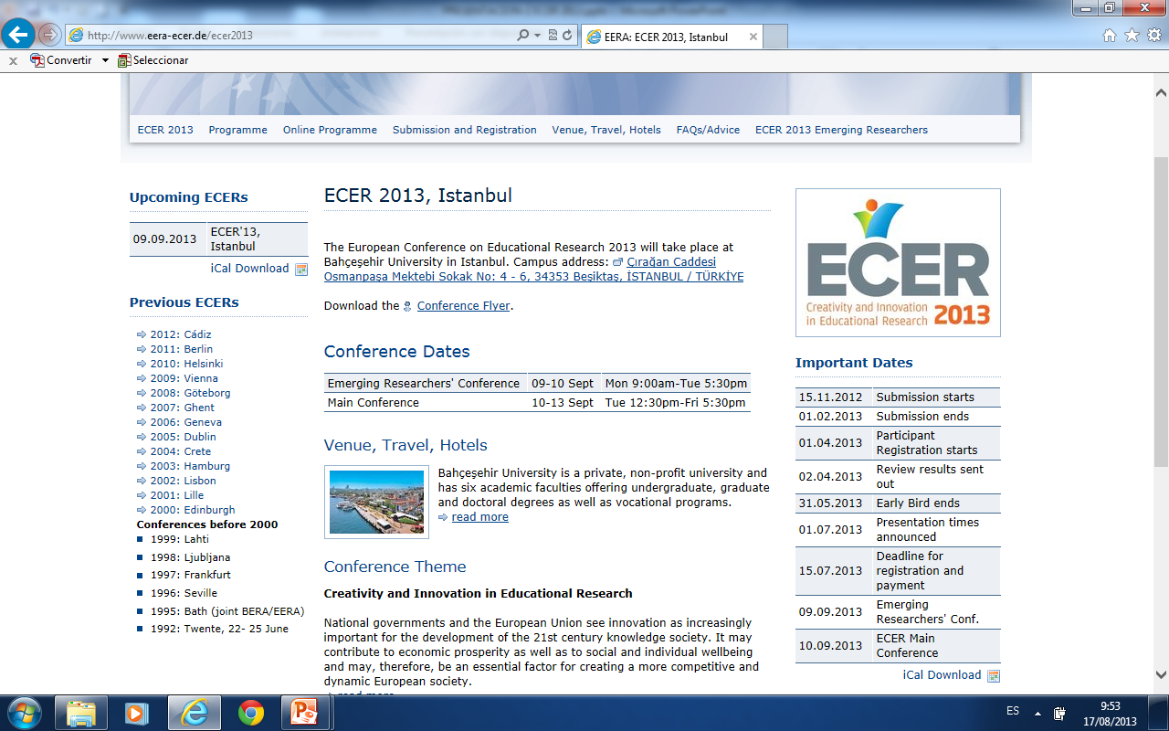
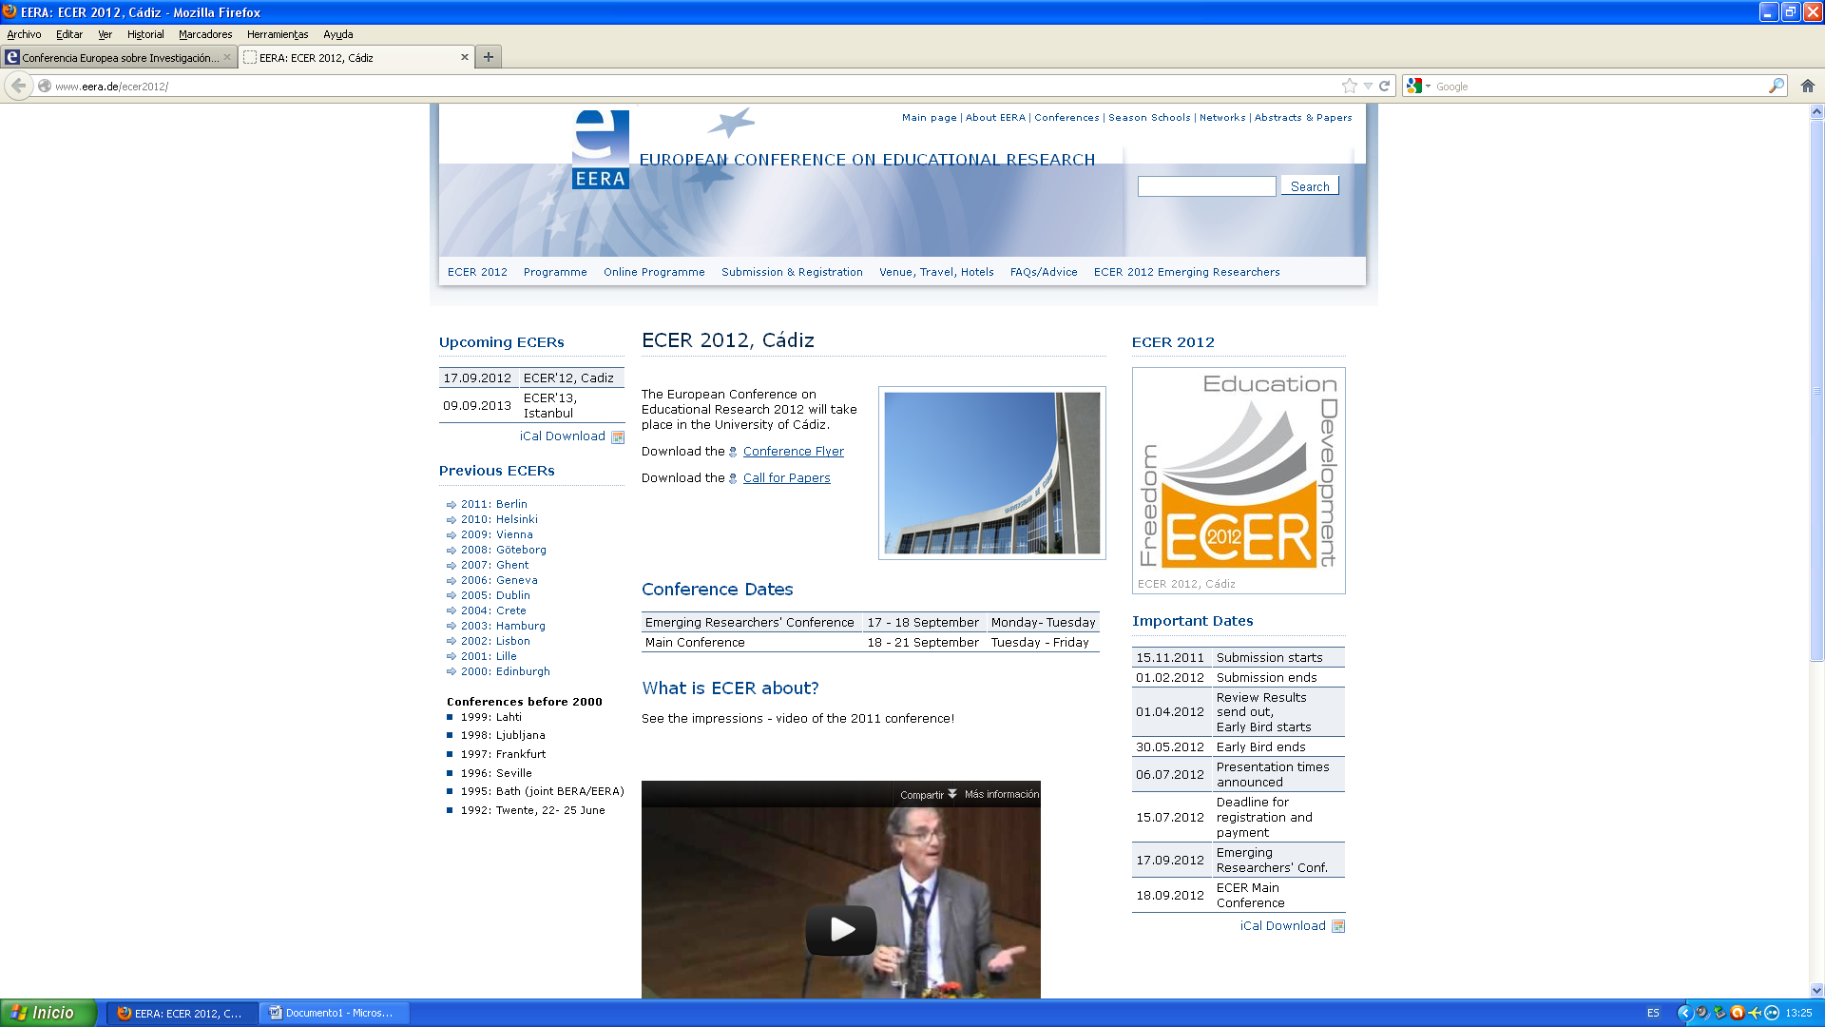
Previous Pedagogical Beliefs Of Freshmen Of Teacher Education Rivas Flores, J.I. ⁽¹⁾; Pérez Ferra, M.⁽²⁾; Leite Méndez, A.E. ⁽³⁾; Quijano López, R. ⁽⁴⁾ y Núñez, C. ⁽⁵⁾ ⁽¹⁾i_rivas@uma.es, ⁽²⁾mperez@ujaen.es, ⁽³⁾aleite@uma.es, ⁽⁴⁾rquijano@ujaen.es, ⁽⁵⁾claudionunez26@hotmail.com Estambul, septiembre de 2013

Slide 2
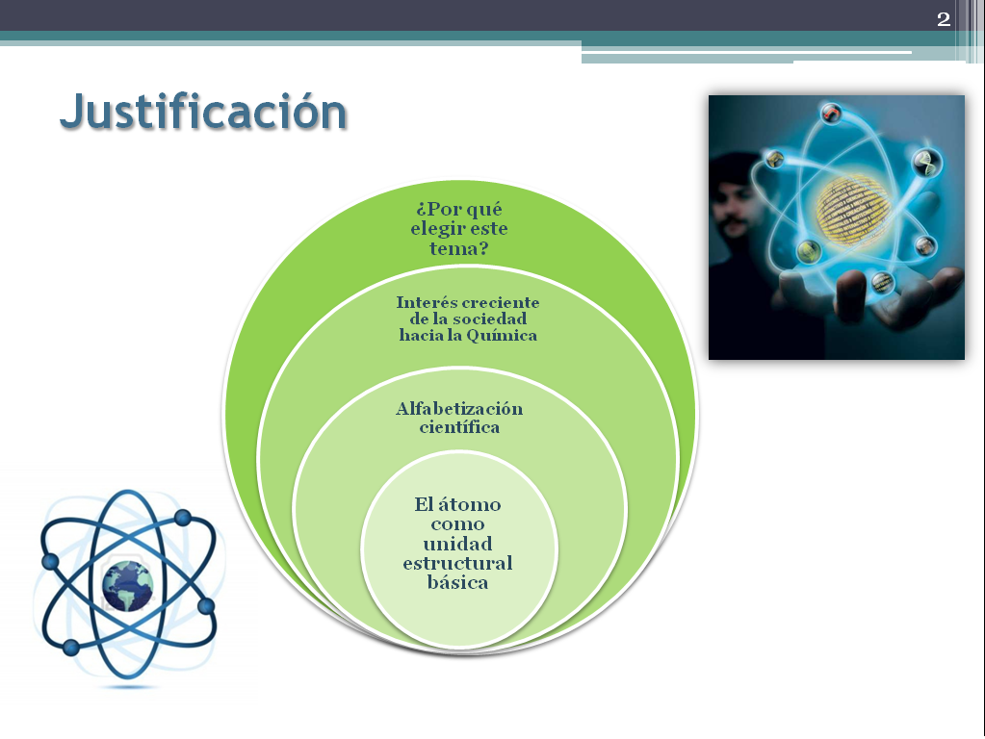
Rivas Flores, J.I. ; Pérez Ferra, M.; Leite Méndez, A.E.; Quijano López, R. y Núñez, C. EERA (Estambul, 2013)
UNIVERSITIES INVOLVED
Spain
Almería
Cádiz
Brasil
Universidade
do Estado
de Santa
Catarina
Córdoba
Granada
Jaén
Málaga

Slide 3
Rivas Flores, J.I. ; Pérez Ferra, M.; Leite Méndez, A.E.; Quijano López, R. y Núñez, C. EERA (Estambul, 2013)
METHODOLOGICAL STRATEGIES
AUTOBIOGRAPHICAL ACCOUNT
TOOLS
METHODOLOGICAL DESIGN:
BIOGRAPHICAL-NARRATIVE RESEARCH
LIFE HISTORY: STUDENTS COUNT THEIR EXPERIENCES OF PRIMARY AND SECONDARY SCHOOL
SPONTANEOUS STORIES BUILT AT THE BEGINNING OF STUDIES IN UNIVERSTY

Slide 4
Rivas Flores, J.I. ; Pérez Ferra, M.; Leite Méndez, A.E.; Quijano López, R. y Núñez, C. EERA (Estambul, 2013)
CONSTRUCTION OF TEACHING PROFESSIONAL IDENTITY
BEGINS…
SCHOOL EXPERIENCES
CONSTRUCTION OF TEACHING PROFESSIONAL IDENTITY
CULTURAL EXPERIENCES
SOCIAL EXPERIENCES

Slide 5
Rivas Flores, J.I. ; Pérez Ferra, M.; Leite Méndez, A.E.; Quijano López, R. y Núñez, C. EERA (Estambul, 2013)
SCHOOL EXPERIENCES
KNOWLEDGE ACQUISITION AND ARTICULATION
DEVELOPMENT OF LEARNING PROCESSES
COMPREHENSION OF CLASSROOM CLIMATE
INDIVIDUALIZATION OF RESPONSABILITY
PERCEPTION OF ORDER
PERCEPTION OF EVALUATION PROCESSES
HOW IS THE SCHOOL EXPERIENCE FROM THE ACCOUNTS, FROM WHICH TEACHER STUDENTS BUILD YOUR “SEDIMENTARY” KNOWLEDGE PROFESSIONAL?
Notes:
Individualización de la responsabilidad: situación
injusta para los alumnos de reprender por los errores, asociándolos a
"falta de atención". Asociar los premios a cuestiones de tipo
ideológico

Slide 6
Rivas Flores, J.I. ; Pérez Ferra, M.; Leite Méndez, A.E.; Quijano López, R. y Núñez, C. EERA (Estambul, 2013)
SCHOOL EXPERIENCES
SCHOOL ACTIVIRY FOCUSED ON TASK
HIERARCHIZATION OF RELATIONSHIPS
REGULATION OF BEHAVIOR BY QUALIFICATIONS
LACK OF EDUCATIONAL CHANGE EXPERIENCES
LACK OF EXPERIENCE OF GENDER
LACK OF COMMUNITY EXPERIENCES
TEACHERS "EXCEPTIONAL"
SOCIAL LINKS AMONG PEERS
Notes:
TAREA---- RUTINAS
JERARQUIZACIÓN---- ORDEN, DISCIPLINA, CONTRO, AUTORIDAD

Slide 7
Rivas Flores, J.I. ; Pérez Ferra, M.; Leite Méndez, A.E.; Quijano López, R. y Núñez, C. EERA (Estambul, 2013)
SOCIO-CULTURAL EXPERIENCES
MANAGERIALIST SOCIETY
STANDARDIZATION OF A HEGEMONIC MODEL
SEARCH FOR HOMOGENEITY
MANAGEMENT VS. SIGNIFICANCE
PACKED CULTURE “PRÊT À PORTER”
CONCERN ABOUT CONTROL AND ORDER
”SHORT-TERMISM” THOUGHT
Notes:
CONTROL Y ORDEN: PREOCUPACIÓN POR LA EVALUACIÓN Y LA CALIDAD

Slide 8
Rivas Flores, J.I. ; Pérez Ferra, M.; Leite Méndez, A.E.; Quijano López, R. y Núñez, C. EERA (Estambul, 2013)
“SEDIMENTAL” PROFESSIONAL KNOWLEDGE
Teaching (mainly) as task structure
Learning as acquisition of curriculum contents
Order is necessary for performance of the tasks
It is only valid what is assessed
Professor Authority regarding the role he/she plays
School as a teacher's professional space
Presence of innatist and geneticist theories
Notes:
Enseñanza como estructura de tareas (solo) – la tarea por la tarea misma.
Aprendizaje como apropiación mecánica de los contenidos del currículum
Importancia del orden para que funcione la clase (se necesita que haya un cierto orden – silencio – para que se pueda empezar a trabajar.
Sólo lo que se evalúa es válido.
Autoridad del profesor (confusión entre autoridad, poder, comunicación…)
La escuela como espacio profesional del docente (ausencia de pensamiento sobre comunidad educativa)
Posiciones cercanas a las teorías genetistas e innatistas.
presentar la idea del cambio de mentalidad con la que llegan los alumnos a la facultad, entendiendo la profesión como un conjunto de tareas, - Se ha perdido el discurso redentorista de la educación. Lo que importa es la tarea en sí misma.

Slide 9
Rivas Flores, J.I. ; Pérez Ferra, M.; Leite Méndez, A.E.; Quijano López, R. y Núñez, C. EERA (Estambul, 2013)
SEDIMENTAL KNOWLEDGE AND INITIAL TRAINING
PERMANENCY OF PREVIOUS KNOWLEDGE DRAWN IN SCHOOL EXPERIENCE
PROBLEMS
PROBLEM TO OBSERVE HOW TEACHERS PRODUCE CHANGES, AS CONSEQUENCE OF REFLECTIVE PRACTICES.
OBSTACLE TO DEEPEN IN THE INAPPROPRIATENESS OF THEIR PREVIOUS IDEAS ON EDUCATION
PROBLEM TO CHANGE THE IDEA OF WHAT IS A TEACHER
PREVIOUS BELIEFS OF STUDENTS ABOUT TEACHING, INFLUENCE HOW THEY INTERPRET THE TRAINING RECEIVED IN COLLEGE

Slide 10
Rivas Flores, J.I. ; Pérez Ferra, M.; Leite Méndez, A.E.; Quijano López, R. y Núñez, C. EERA (Estambul, 2013)
PROPOSALS FOR TEACHER EDUCATION
Understand and analyse personal and training profiles of teacher education freshman.
Determine how previous pedagogical beliefs of freshmen in teacher education affect on how to integrate the teachings professionalizing received in college..
Promote in teacher education students, the development of criteria that allow them to recognize and analyse prior beliefs about teaching and determine their value

Slide 11
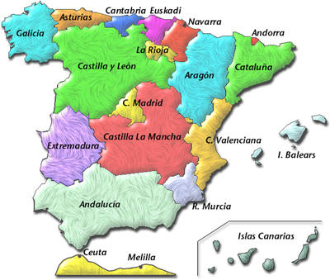
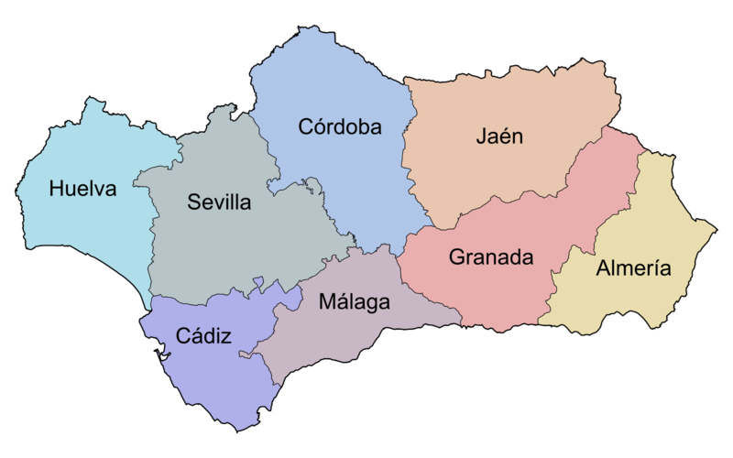
Previous Pedagogical Beliefs Of Freshmen Of Teacher Education Rivas Flores, J.I. ⁽¹⁾; Pérez Ferra, M.⁽²⁾; Leite Méndez, A.E. ⁽³⁾; Quijano López, R. ⁽⁴⁾ y Núñez, C. ⁽⁵⁾ ⁽¹⁾i_rivas@uma.es, ⁽²⁾mperez@ujaen.es, ⁽³⁾aleite@uma.es, ⁽⁴⁾rquijano@ujaen.es ⁽⁵⁾claudionunez26@hotmail.com Estambul, septiembre de 2013
THANK YOU

