Slide 1
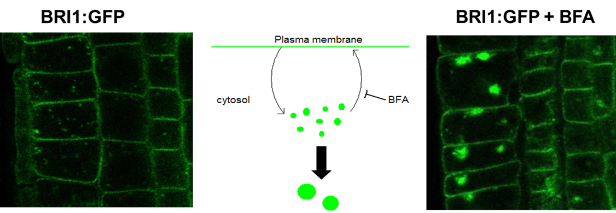
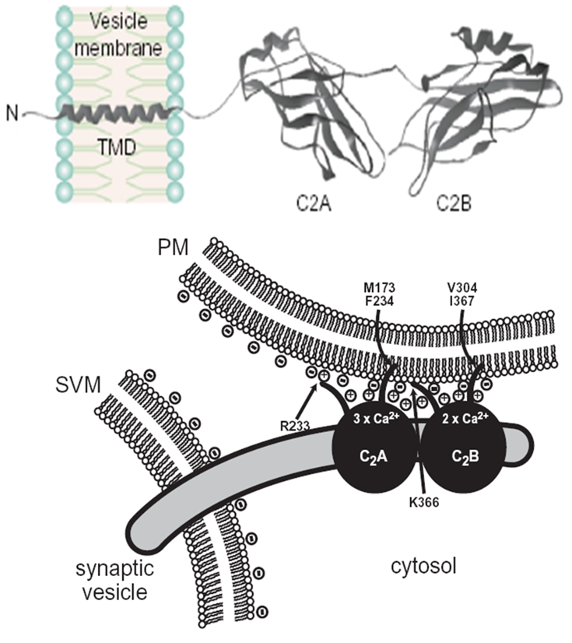
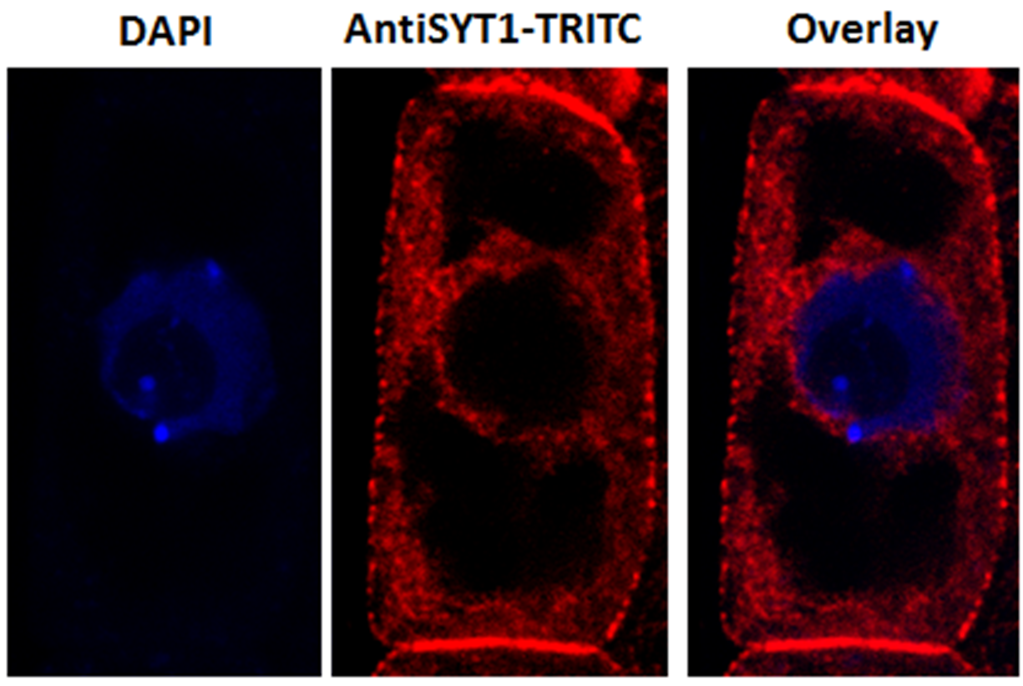
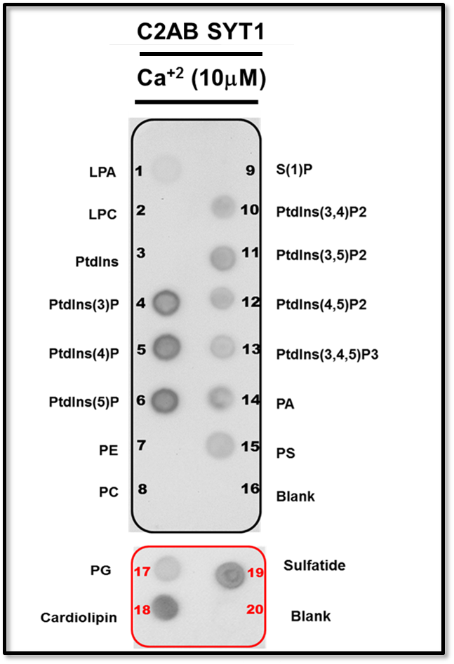
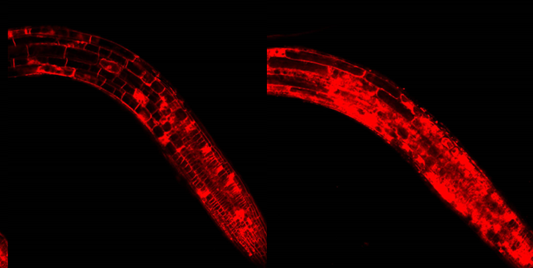
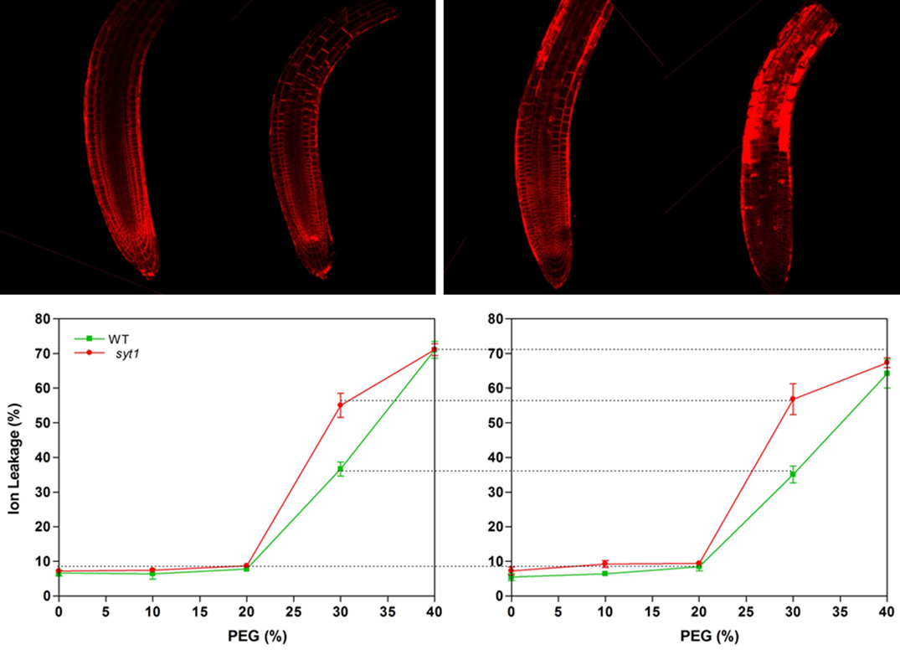
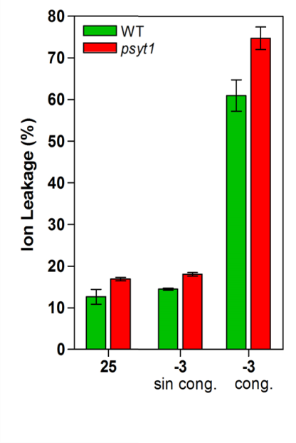
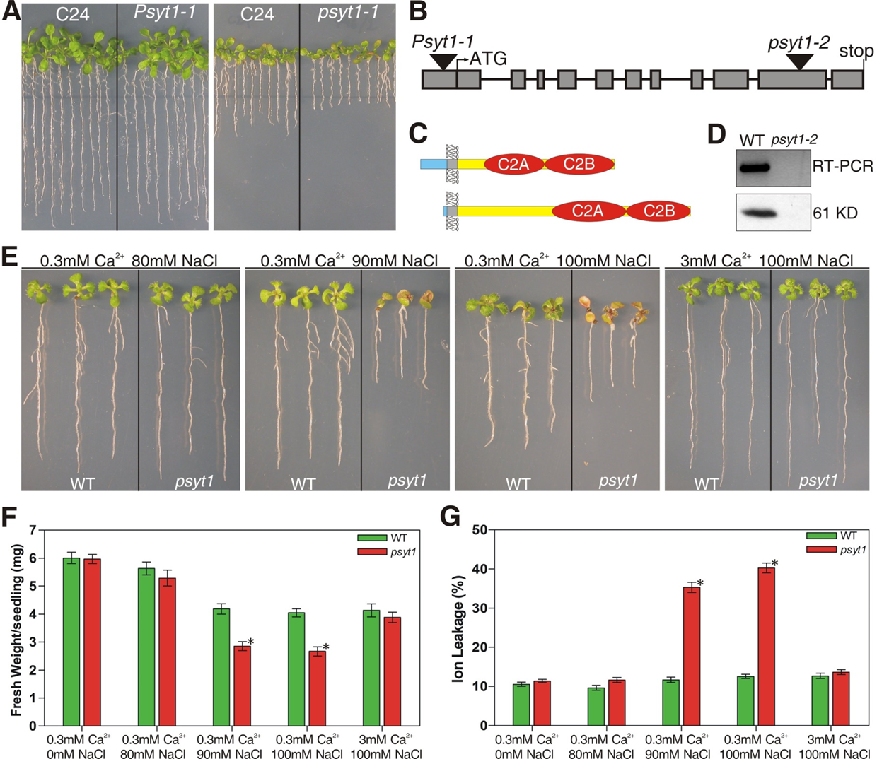
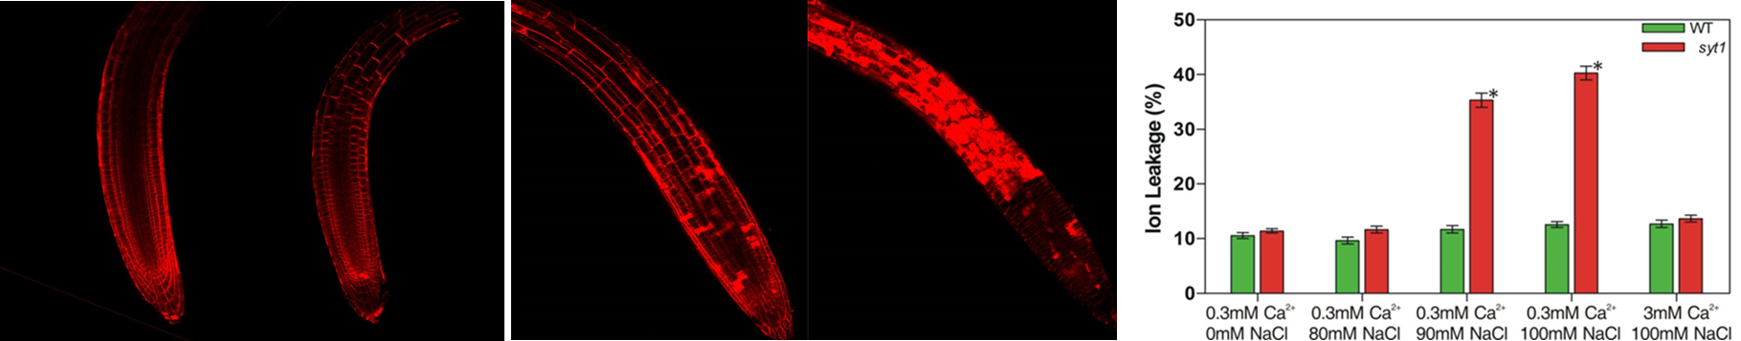
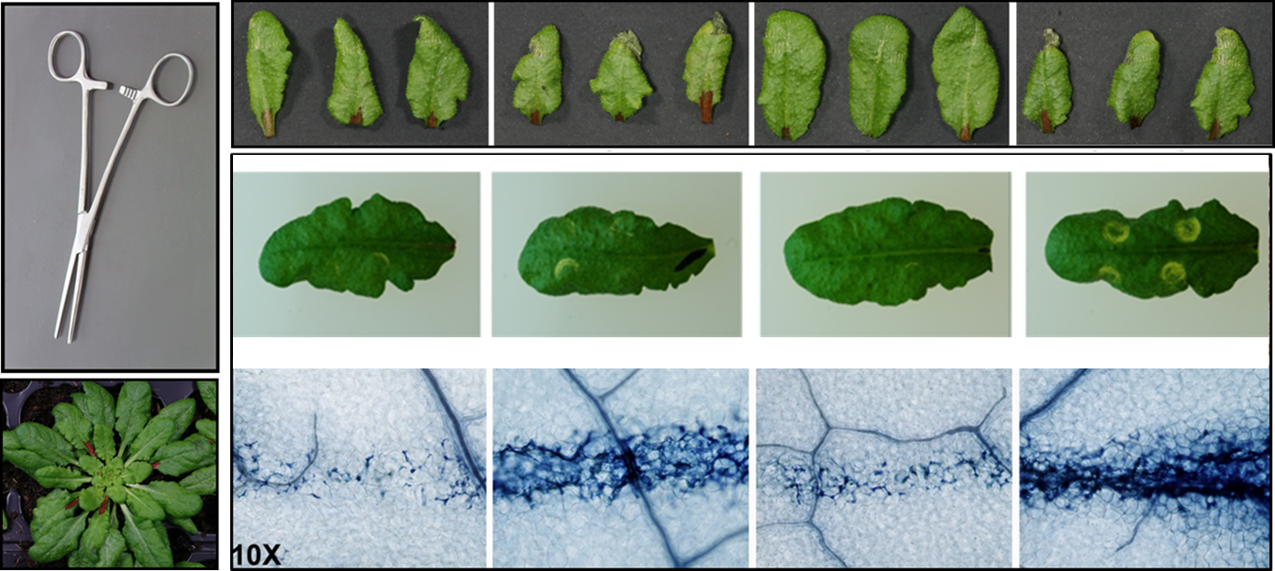
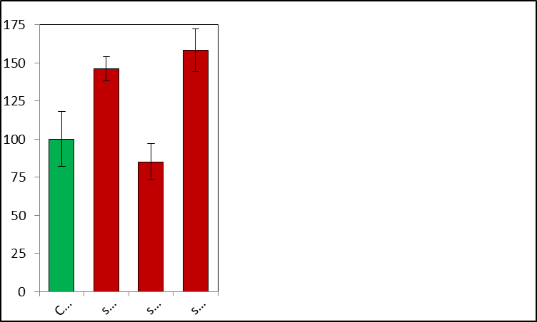
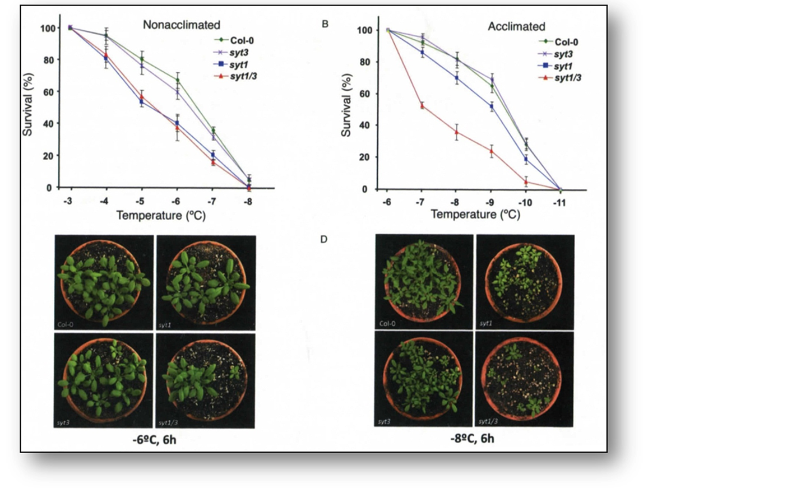
Synaptotagmin 1 regulates membrane fusion events
that are essential for abiotic stress tolerance in plants
Jessica Pérez- Sancho1, Arnaldo L. Schapire1, Carlos Perea-Resa2, Abel Rosado1, Julio Salinas2, Miguel Ángel Botella1
1 Departamento de Biología Molecular y Bioquímica, Instituto de Hortofruticultura Subtropical y Mediterránea, Universidad de Málaga-Consejo Superior de Investigaciones Científicas,
29071, Málaga, Spain.
2 Departamento de Biología Medioambiental, Centro de Investigaciones Biológicas, Consejo Superior de Investigaciones Científicas, 28040 Madrid, Spain.
Plants undergo continuous exposure to various abiotic stresses in their natural environment. For this reason they have evolved intricate mechanisms to perceive external signals and trigger the physiological changes necessary to adapt and survive under such conditions. The plasma membrane is a physical barrier that separates the intracellular and extracellular environments and its integrity is essential for stress tolerance. Here we present a role for plant synaptotagmins in plasma membrane integrity maintenance through Vesicle-PM fusions. We also evaluate the physiological consequences of the SYT depletion under several abiotic stress conditions.
Vesicle – PM fusions are required for stress tolerance
PM localized plant SYTs binds membrane lipids
A
C
BFA as a marker of Vesicle-PM fusions. BFA is a vesicle fusion inhibitor (A) that causes the lost of PM integrity after stress as observed by FM4-64 labelling (B).
Animal SYTs fuse membranes in a Ca2+ dependent manner. Structural domains of a canonical SYT (C). Vesicle-PM fusion mediated by SYTs requires phospholipid binding and Ca2+.
A
B
Arabidopsis SYT1 is PM localized. Immunolocalization of SYT1 in root meristematic cells using specific Anti-SYT1 antibodies. SYT1 signal is characterized by a punctated pattern in the PM (A).
SYT1 shows high affinity for negatively charged phospholipids
Protein-Membrane Lipid overlay assays were performed with purified SYT1 soluble C2 domains and developed with specific Anti-SYT1 antibodies (B).
B
D
SYTS MUTATION CONNECT CELLULAR MEMBRANE FUSIONS WITH WHOLE PLANT HYPERSENSITIVITY TO ABIOTIC STRESS
Hydric Stress
A
Salt Stress
A
B
ºC
C
Col
syt1
Col
syt1
NF F
B
C
Col
syt1
Col
syt1
Control
30% PEG, 30min
syt1 hydric hypersensitivity correlates with defects in vesicle-PM fusions. Hydric sensitivity in WT and syt1 backgrounds was assessed by measuring ion leakage after PEG (A) and cold/freezing (B) treatments. After 30% PEG treatment syt1 displays enhanced PM defects resembling those of BFA treatment (C).
Control
100mM NaCl, 30min
syt1 hypersensitivity to salt stress is Ca2+ dependent. Low Ca2+ concentration (0.3mM) enhances the syt1 growth hypersensitive phenotype (A) and cellular damage (B) of NaCl treated seedlings. After 100mM NaCl treatment (under 0.3mM Ca2+) syt1 displays enhanced PM defects resembling those of BFA (C).
Mechanical Stress
Cold Stress
A
D
B
C
Ion Leakage (%)
T (ºC)
Col
syt1
syt3
syt1/3
The PM defects in syt1 and syt1/syt3 translate into mechanical hypersensitivity at the tissular level. Leaves from adult plants from the different genotypes were mechanically damaged at constant pressure using an hemostat (A) or a syringe (B). The extend of the damage was assesed using trypan Blue staining (C) and ion leakage (D).
T (ºC)
Different SYTs have specific roles in cold stress tolerance. While SYT1 is constitutively required for freezing stress tolerance, SYT3 is only required for acclimation processes in the syt1 background. Nonacclimated plants were directly subjected to the indicated freezing temperatures. Acclimated plants were exposed for 1 week to 4 oC prior to the freezing stress
This work has been supported by Spanish Ministry of Economy and competitivity FPI-BES 2012 -052324 and the Marie Curie FP7 People Action IIF-FP7 301419
Notes:
<number>

Slide 2
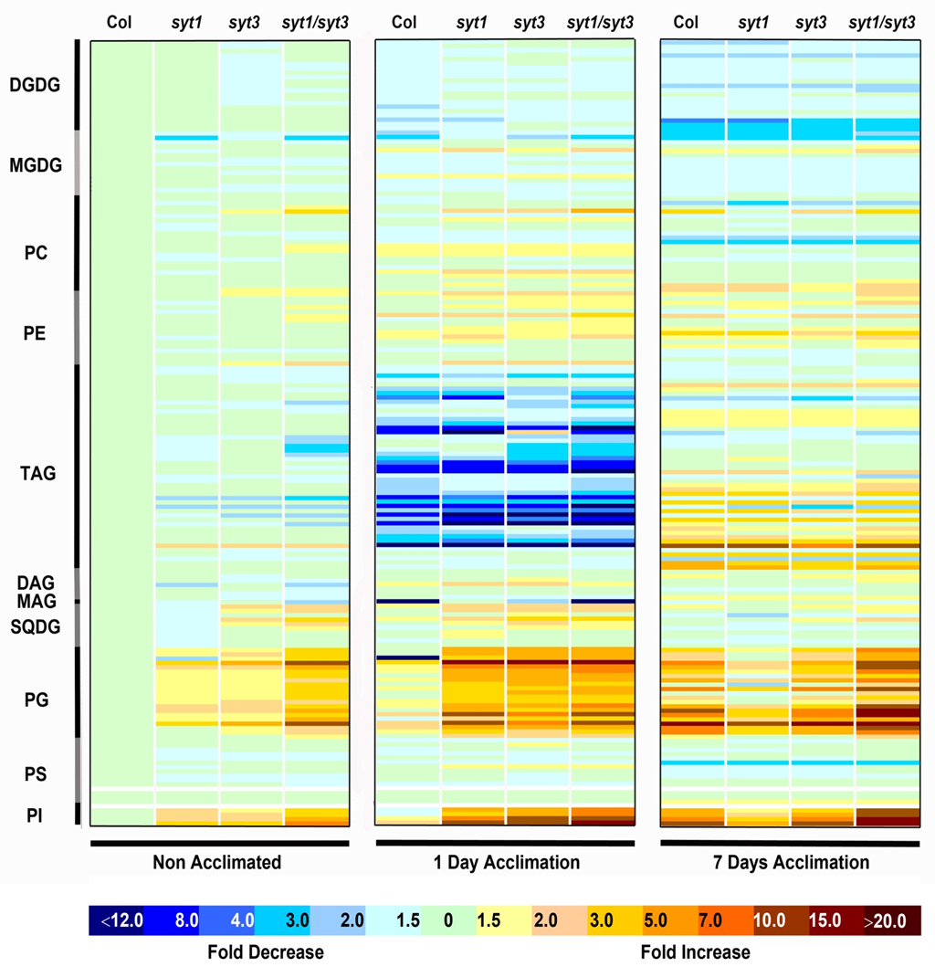
T (ºC)
T (ºC)

