Slide 1



Associative versus rule-based generalisation: A dissociation between judgements and priming effects
Gutiérrez Cobo, María José
Luis Cobos Cano, Pedro
Flores Martín, Amanda

Slide 2
CONTINGENCY LEARNING
INFERENTIAL PROCESSES
ASSOCIATIVE PROCESSES
Slow
Rule based
Goal driven
A good amount of resources from working memory
Fast and automatic
Weight update through associative algorithms
Incidental
Few resources from working memory

Slide 3
CONTINGENCY LEARNING
Dependent measures
Verbal judgments:
Allow for associative and inferential processes
Indirect behavioural measures:
Assumed to be more reliable for associative learning processes (priming, IAT)

Slide 4
Indirect behavioural measures
Increasing use in human contingency learning:
a) Recognition priming (Morís et al., 2013, JEPG)
b) Cued response priming task (González Martín et al., 2012; Cobos et al., 2013, JEPA)
However, to what extent are these tasks effective in precluding inferential reasoning processes?
De Houwer & Vandorpe (2010) found evidence of rule-based responses (i.e., reasoning processes) by using an implicit association test (IAT)

Slide 5
Objetive
To assess whether the cued response priming task precludes inferential reasoning processes and promotes the expression of associative processes

Slide 6
Experiment 1
1
Learning phase
Verbal judgments phase
Priming test
2
3

Slide 7
Experiment 1
Phase 1:
LEARNING PHASE
(Similar to Shanks & Darby,1998)
Single trials | Compound trials
A-O1, B-O1 | AB-O2
C-O2, D-O2 | CD-O1
 | EF-O1
 | GH-O2
The RULE was explicitly explained through INSTRUCTIONS

Slide 8

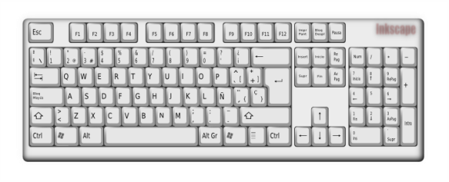

Experiment 1
Phase 1:
LEARNING PHASE
On each trial, either one or two geometric figures were presented
Feedback after the participant’s prediction
If this geometric figure makes you think that the smiley face will appear on the left side press “F” and if you think that it will appear on the right side, press “K”
You earn 10 points
Total of points = 10
B

Slide 9
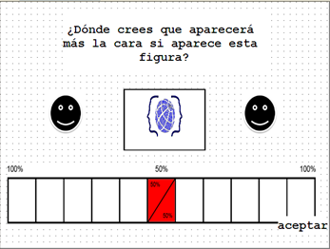
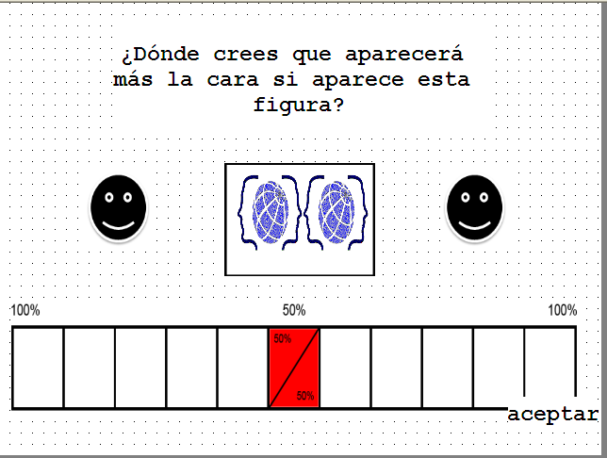
Experiment 1
Phase 2:
VERBAL JUDGEMENTS
Single cues
(including “E”, “F”, “G”, “H”)
Compound cues
Where do you think that the smily face will appear if this figure appears?
Where do you think that the smily face will appear if this figure appears?

Slide 10
Experiment 1
Single trials | Compound trials
A-O1, B-O1 | AB-O2
C-O2,D-O2 | CD-O1
 | EF-O1
 | GH-O2
If participants rely on associative processes, they should expect E, F, G and H on their own to be followed by the same outcome as when they are in compound
If participants use inferential processes they should expect E, F, G and H on their own to be followed by the outcome opposite to that which appeared in compound trials

Slide 11

Experiment 1
Single trials | Compound trials
A-O1, B-O1 | AB-O2
C-O2,D-O2 | CD-O1
 | EF-O1
 | GH-O2
Results verbal judgements
N = 44
02
O1= 0
O2= 100
01

Slide 12
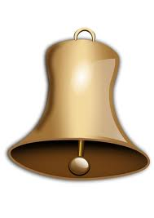
Experiment 1
Phase 3:
PRIMING TEST based on cued response priming (or Posner’s) task
B
C
2000ms
200ms (SOA)
Until a key was pressed

Slide 13
Experiment 1
Phase 3:
PRIMING TEST based on cued response priming (or Posner’s) task
Design
Single trials | Compound trials
A-O1, B-O1 | AB-O2
C-O2,D-O2 | CD-O1
E-02, F-01 | EF-O1
G-02, H-01 | GH-O2
Rule based pairing
Associative based pairing

Slide 14
Experiment 1
Single trials | Compound trials
A-O1, B-O1 | AB-O2
C-O2,D-O2 | CD-O1
E-02, F-01 | EF-O1
G-02, H-01 | GH-O2
If participants engage in associative processes, they should be faster on F and G than on E and H trials
If participants engage in rule-based processes, they should be faster on E and H than on F and G trials

Slide 15
Experiment 1
Single trials | Compound trials
A-O1, B-O1 | AB-O2
C-O2,D-O2 | CD-O1
E-02, F-01 | EF-O1
G-02, H-01 | GH-O2
Results priming task
Reaction time
N = 43
PRIMING TEST
Trial
Trial: [F(9, 1864.229) = 4.578, p <0.001]
Type of pairing: [F(1, 1864,080) = 10.502, p = 0.001]

Slide 16
Experiment 1
Discussion
When participants had enough time to think, as in verbal judgements, they used the rule
When participants performed the priming task under a short SOA condition, responses were consistent with associative processes
However, the use of a priming task does not necessarily preclude inferential reasoning processes under longer SOA conditions

Slide 17
Objetive
Experiment 2
To test whether the expression of rule-based vs associative processes is modulated by the SOA between the prime and the target

Slide 18
Experiment 2
1
Learning phase
Causal judgments phase
Priming test
Same as in Experiment 1
2
3
Two groups:
1. SOA: 200ms
2. SOA: 1300ms

Slide 19
Experiment 2
Simple trials | Compound trials
A-O1, B-O1 | AB-O2
C-O2,D-O2 | CD-O1
 | EF-O1
 | GH-O2
Results judgement task
N = 80
O2
O2
CAUSAL JUDGMENT
**
CAUSAL JUDGMENT
**
**
**
O1
O1
SOA 200 ms
SOA 1300 ms

Slide 20
Experiment 2
Simple trials | Compound trials
A-O1, B-O1 | AB-O2
C-O2,D-O2 | CD-O1
 | EF-O1
 | GH-O2
Results priming task
N = 70
Reaction time
Trial
SOA Group: [F(1, 65.578) = 15.768, p<0.001]
Type of pairing: [F(1, 2447.882) = 6.830, p<0.001]
SOA Group * Type of pairing: [F(1, , 2447.882) = 14,161, p<0.001]

Slide 21
Experiment 2
Results priming task
SOA 200 ms
Reaction time
Trial
Type of pairing: [F (1, 1145.488) = 20.959, p<0.001]

Slide 22
Experiment 2
Results priming task
SOA 1300 ms
Reaction time
Trial
Type of pairing: [F (1, 1303.138) = 0.656, p = 0.418]

Slide 23
Experiment 2
Results priming task
2 TRIALS
Reaction time
Trial
SOA Group * Type of pairing: [F (1, 411.069) = 11.190, p = 0.001]

Slide 24
Experiment 2
Results priming task
SOA 200 MS (2 TRIALS)
Reaction time
Trial
Type of pairing: [F (1, 187,475) = 5.648, p = 0.018]

Slide 25
Experiment 2
Results priming task
SOA 200 MS (2 TRIALS)
Reaction time
Trial
Type of pairing: [F (1, 222,592) = 5.765; p = 0.017]

Slide 26
Experiment 2
Under long SOA conditions, the priming effects are consistent with reasoning processes during the first trials
Discussion

Slide 27
General discussion
When participants had enough time to think,
they used the rule
When participants were in a priming task...
Their responses were consistent with associative processes when the SOA was short enough
Their responses were consistent with inferential reasoning processes when the SOA was long enough

Slide 28
General discussion
The cued response priming task is more effective than IAT to preclude reasoning processes and to promote the expression of associative processes
Hence the difference between our results and De Houwer & Vandorpe’s

Slide 29
Thanks for your attention

Slide 31
EXPERIMENT 2
SOA 200ms

Slide 32
EXPERIMENT 2
SOA 1300ms

