Slide 1

XVI DIABESITY SURGERY MEETING UNIVERSITY MALAGA/SPAIN March 7-8 2014
Bariatric procedures currently used for diabetes:
Basic considerations of study designs to demonstrate efficacy and
effectiveness in bariatric surgical research for diabetes
Edmund A.M. Neugebauer
Institute for Research in Operative Medicine (IFOM)
Director: Univ. Prof. Dr. Prof. h.c. Edmund A. M. Neugebauer
Chair for Surgical Research
Witten/Herdecke University, Campus Cologne
Ostmerheimer Str. 200, 51109 Cologne,
Germany

Slide 2

Outline of my talk
RCT`s and metaanalyses of bariatric surgery for Type II diabetes
Status Quo- randomized controlled trials?
Outcome measures and confounders ?
Systemetic reviews and metaanalyses
- Risk of bias assessment ?
- Strengths and limitations ?
The efficacy and effectiveness gap
Summary and conclusion

Slide 3
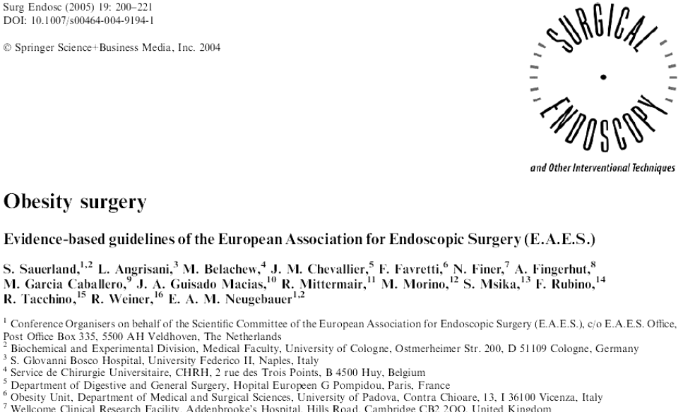
2005

Slide 4
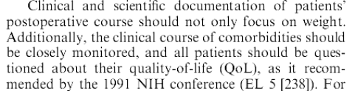
Evidence based Guidelines of the EAES on Obesity Surgery 2005
Recommendation:

Slide 5
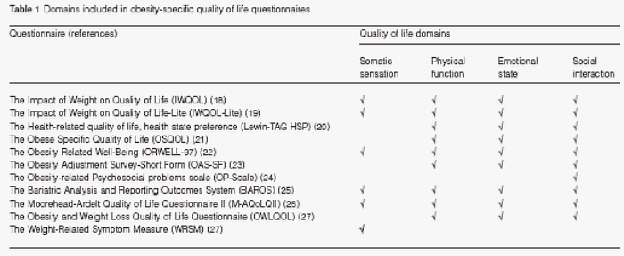
Obesity specific QoL Questionaires
The IWQOL-Lite has only 31 items,
is used in many studies,
and its interpretability is excellent
Duval et.al. Obesity reviews (2006) 7, 347–360

Slide 6
2014:
Is there a role for surgery in the treatment of type 2 diabetes?
Bariatric surgery is proven to be a safe and effective therapeutic option in obese patients that leads to a significant weight loss associated with improved insulin sensitivity.
In the majority of obese diabetics, a complete or partial remission of T2DM is observed.
Little is known about the long-term effect of bariatric surgery on diabetes remission.
Bariatric procedures should be considered in obese patients with T2DM (BMI > 35 kg/m2) and poorly controlled metabolic status.
Despite the encouraging results in normal weight or overweight patients with T2DM, surgery can not yet be recommended in these patients.
Benedix et.al Dtsch Med Wochenschr. 2014 Jan;139(5):207-12. doi: 10.1055/s-0033-1359931. Epub 2014 Jan 21.

Slide 7
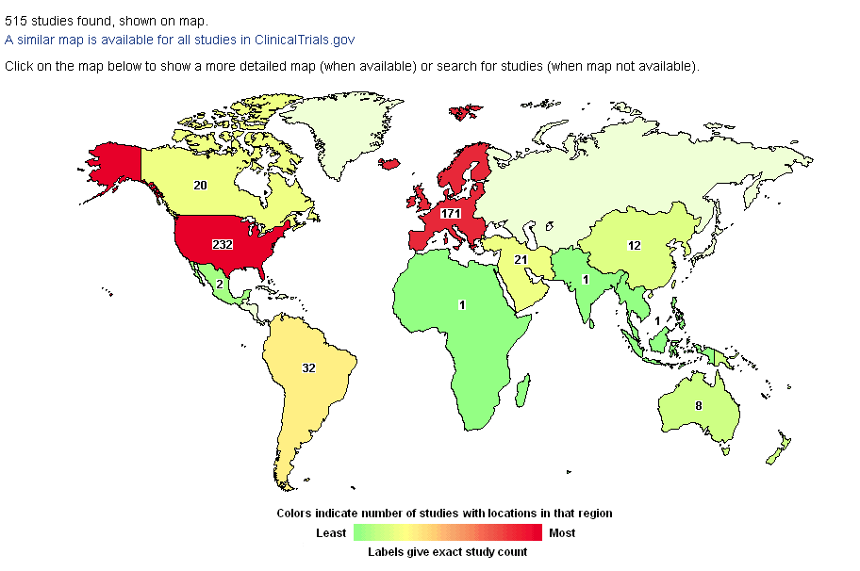
Bariatric Surgery- Studies worldwide
515 studies found for: Bariatric surgery

Slide 8

515 studies found for : bariatric surgery
236 studies found for: surgery in the treatment of type 2 diabetes
10 studies found for: randomized controlled studies in bariatric surgery for Type II diabetes
7/10 real studies found for: randomized controlled studies in bariatric surgery for Type II diabetes
only 1 study completed

Slide 9
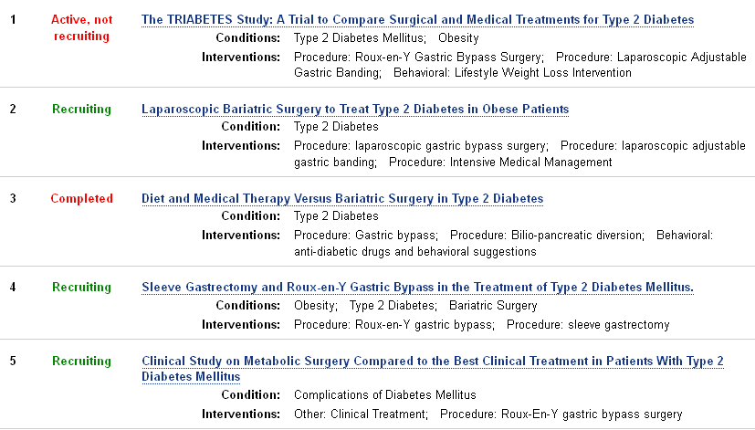
Randomized controlled studies in bariatric surgery for Type II diabetes
n= 1-5

Slide 10
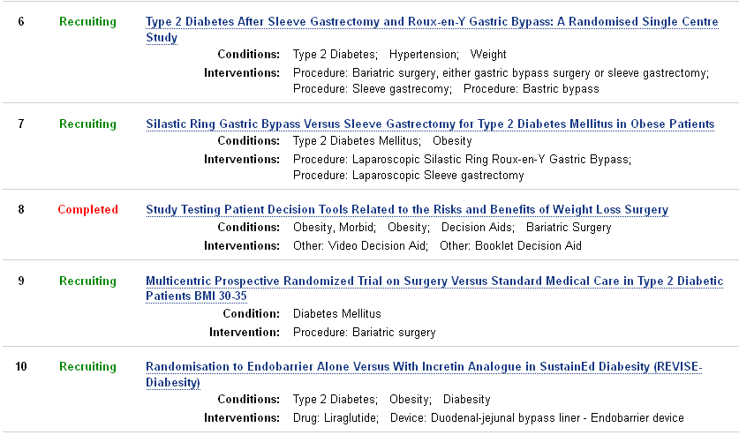
Randomized controlled studies in bariatric surgery for Type II diabetes
n= 6-10

Slide 11
Study 3: N Engl J Med 2012;366:1577-85.
Diet and Medical Therapy Versus Bariatric Surgery in Type 2 Diabetes (DIBASY) ClinicalTrials.gov Identifier: NCT00888836
Sponsor: Catholic University of the Sacred Heart , Italy
PI: Geltrude Mingrone, Catholic University of the Sacred Heart
Single-center, nonblinded, randomized, controlled Trial on the Effect of Gastric Bypass and Biliopancreatic Diversion on Type 2 Diabetes Mellitus in Patients With BMI > 35 vs. Medical Therapy
Enrollment : 60 Patients,
Completed: November 2011
The study was powered to detect an absolute difference of 65 percentage points in the rate of remission of type 2 diabetes between the gastric bypass
group and the medical-therapy group
http//clinicaltrials.gov/ct2/show/record/NCT00888836?term=
randomized+controlled+Studies+in+bariatric+surgery+for+Type+II+diabetes&rank=3

Slide 12
Patients
Inclusion Criteria:
patients with type 2 diabetes and BMI ≥35 kg.m-2
age between 30 and 60 years
duration of diabetes ≥ 5 years
poor glycemic control (i.e., HbA1c ≥ 7.0%) in spite a medical antidiabetic therapy in accordance with good clinical practice (GCP)
Exclusion Criteria:
pregnancy
medical conditions requiring acute hospitalisation
severe diabetes complications or associated medical conditions (such as blindness, end-stage renal failure, liver cirrhosis, malignancy, chronic congestive heart failure)
recent (within preceding 12 months) myocardial infarction, stroke or TIA unstable angina pectoris
psychological conditions which may hamper patient's cooperation geographic inaccessibilit
any condition which, in the judgement of the Investigator, may make risky the participation in the study or bias the results

Slide 13
Intervention and Control
Intervention 1: Procedure: Gastric bypass
Type 2 diabetic subjects with BMI ≥ 35, poor glycemic control (HbA1c ≥ 7.0%) and diabetes duration ≥ 5 years undergo gastric bypass
Intervention 2 : Procedure: Bilio-pancreatic diversion
Type 2 diabetic subjects with BMI ≥ 35, poor glycemic control (HbA1c ≥ 7.0%) and diabetes duration ≥ 5 years undergo bilio-pancreatic diversion
Intervention 3 : Behavioral: anti-diabetic drugs and behavioral suggestions
Type 2 diabetic subjects with BMI ≥ 35, poor glycemic control (HbA1c ≥ 7.0%) and diabetes duration ≥ 5 years undergo medical therapy
Mingrone et.al N Engl J Med 2012;366:1577-85

Slide 14
Outcome
The primary end point
was the rate of diabetes remission* at 2 years
*defined as a fasting glucose level of <100 mg per deciliter [5.6 mmol per liter] and a glycated hemoglobin level of <6.5% in the absence of pharmacologic therapy
Mingrone et.al N Engl J Med 2012;366:1577-85

Slide 15
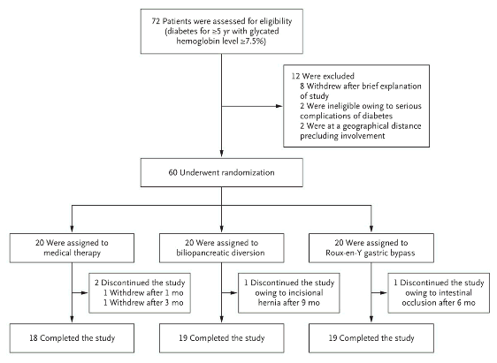
Study design: Enrollment and Outcomes
Mingrone et.al N Engl J Med 2012;366:1577-85

Slide 16
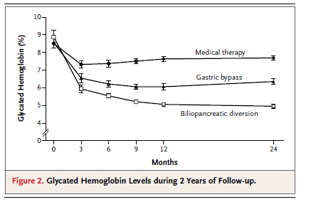
Results:
Mingrone et.al N Engl J Med 2012;366:1577-85
Preoperative BMI and weight loss did not predict
the improvement in hyperglycemia after these procedures.
At 2 years, diabetes remission had occurred in no patients in the medical-therapy
group versus 75% in the gastric-bypass group and 95% in the biliopancreatic-diversion
group (P<0.001 for both comparisons

Slide 17
Limitations of the study
The number of patients, although fulfilling the sample-size requirement, was relatively small >larger multicenter studies will be required to confirm the findings
The study did not have sufficient power to analyze safety or to detect differences in other important end points, such as rates of death or cardiovascular events and differences in long-term morbidity between the two surgical procedures.
Eligibility criteria did not include cutoffs for dyslipidemia or arterial blood pressure, and eligible patients underwent randomization as they presented
The longer-term outcome is unclear because of the potential for recurrence of hyperglycemia.
Mingrone et.al N Engl J Med 2012;366:1577-85

Slide 18
Short excursion on outcome

Slide 19
Outcome measures
Outcome: Achieving the „best“ outcome is the goal of all clinical medicine (Little, 1993)
quantitative • mortality rates
• survival time • complication rates
qualitative • convalescence • quality of life • autonomy
quantitative • laboratory / functiontests • histology • bacteriology
quantitative • costs • cost-effectiveness • cost-benefit
clinical
biological
economical

Slide 20
The optimal outcome measure should…
➔ cover the main problem of the patient (clinical relevance)
➔ respond to changes of the intervention (sensitivity)
➔ be objective and reproducible (reliability)
➔ be simple in handling and evaluation (practicability)
➔ be of relevance for further clinical decision making

Slide 21
The problem of biological variables as outcome parameters to demonstrate a treatment effect
biological parameter
- laboratory data - bacteriology - function tests - histology - immune status - etc.
biological effect („Does it work?“)
clinical parameter
- mortality rate - organ dysfunction - convalescence - discomfort - disability - autonomy - etc.
clinical effect
(„Does it help?“)
Surrogates

Slide 22
Physician-Patient-Relationship
Pain, fear, symptoms
physician ⬅➔ patient
physician ⬅➔ patient
Intervention
Op theatre, ICU, ward
„How are you?“
Indication for treatment; patient-specific aims and individuality considered ?
„How are you?“
Patient-specific aims fulfilled?
A true endpoint is „how the patient, under the current circumstances and at this particular time, is handling the symptoms and the treatment.“
Troidl (1989) Langenbeck‘s Arch Surg Suppl II, 101-107

Slide 23
Study Testing Patient Decision Tools Related to the Risks and Benefits of Weight Loss Surgery (ClinicalTrials.gov Identifier: NCT00666952
The main objective of the current proposal is to examine the impact of a bariatric decision aid Weight loss surgery: Estimated Enrollment: 150
Responsible Party: Dr. David Arterburn, MD, MPH, Assistant Investigator, Group Health Research Institute Seattle, Washington, United States
No publications provided
ClinicalTrials.gov processed this record on February 27, 2014

Slide 24
Study Testing Patient Decision Tools Related to the Risks and Benefits of Weight Loss Surgery (ClinicalTrials.gov Identifier: NCT00666952
The main objective of the current proposal is to examine the impact of a bariatric decision aid Weight loss surgery: Estimated Enrollment: 150
The primary aims of this of this research are to:
Determine if the bariatric decision aid results in superior bariatric surgery decision quality than an NIH booklet on weight loss surgery ('usual care').
Determine if the bariatric decision aid results in less decisional conflict and superior decisional self-efficacy than usual care.
Determine if there is a differential effect of the interventions on decision quality among treatment seekers and non-treatment seekers.
Investigate medical, psychological, and behavioral factors as mediators of treatment choice.
Very important field for the future!!!!!!

Slide 25
Individual factors with influence on outcome (confounders)
Placebo effect personality, social circumstances and culture of the surgeon and the patient
Motivation socio-economic and cultural aspects (insurance conditions, role models)
Time change of values of patients and hierarchy of endpoints
Social context inferences with economic estimates may mislead because they focus on disease and not on the individual patient
Troidl H (1998) In: Surgical Research - Basic Principles and
Clinical Practice, pp 303-319

Slide 26
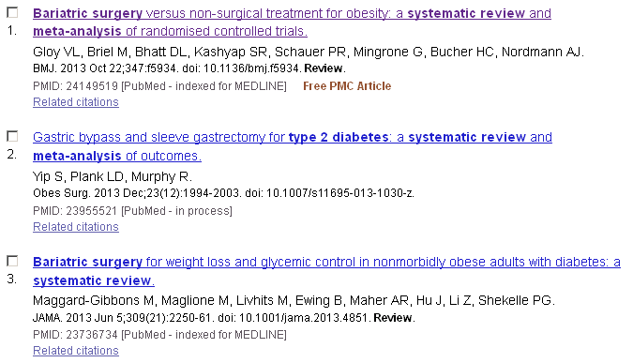
Bariatrc surgery : Systemetic reviews and metaanalyses 2013
Total n=10

Slide 27
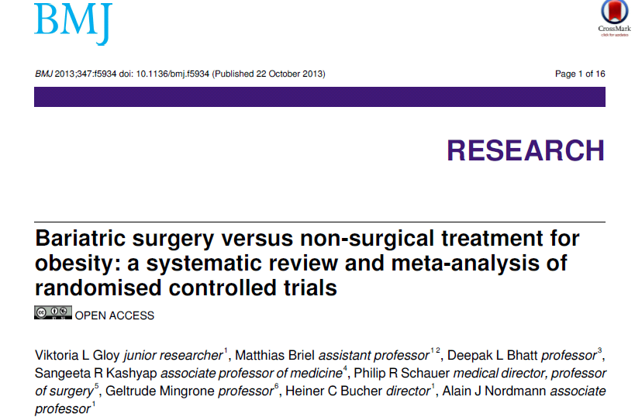

Slide 28
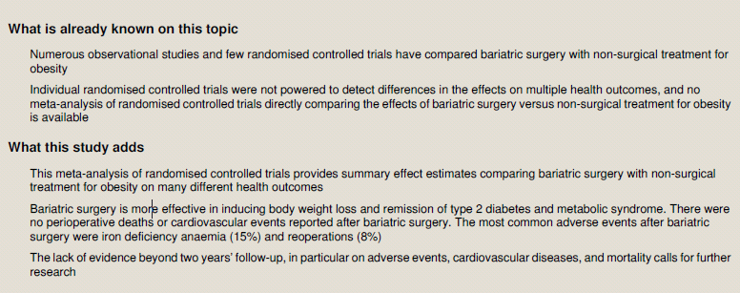
Bariatric surgery versus non-surgical treatment for obesity: a systematic review and meta-analysis of RCT`s
BMJ 2013;347:f5934 doi: 10.1136/bmj.f5934 (Published 22 October 2013)

Slide 29
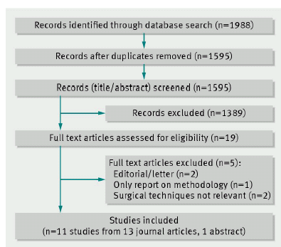
Bariatric surgery versus non-surgical treatment for obesity: a systematic review and meta-analysis of RCT`s
BMJ 2013;347:f5934 doi: 10.1136/bmj.f5934 (Published 22 October 2013)

Slide 30
Risk of bias assessments for studies included in metaanalyses
Population
Intervention
Blinding
(Health care provider, Patient, Analysis)
Outcome Assessment
Control
Blinding
(Health care provider, Patient, Analysis)
Targetpopulation
Randomisation
Reporting
Outcome Assessment
Blinding (Doctor,Patient, Analysis)
Selection Bias
Performance Bias
Detection Bias
Attrition Bias
Reporting Bias
Quelle: in Anlehnung an Boutron, o.J.

Slide 31
Cochrane Risk of Bias tool
Risk of bias assessments for studies included in metaanalyses
Selection Bias
Sequence Generation
Allocation sequence concealment
Performance Bias
Blindung (Health Care Provider, Patient)
Detection Bias
Blindung (Analysis)
Attrition Bias
Reporting Bias
Incomplete outcome data
Selective outcome reporting
Other Bias

Slide 32
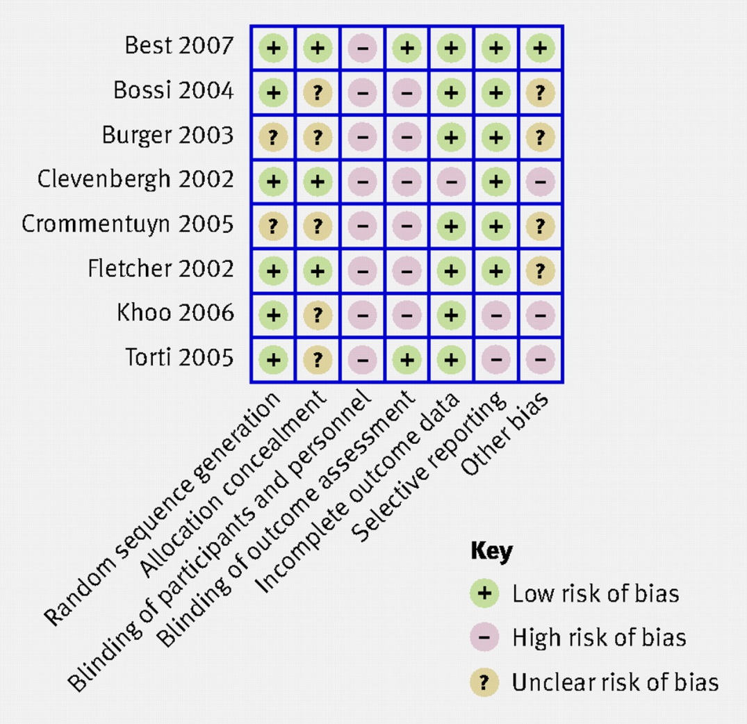

Assessment example
Fig 1 Example presentation of risk of bias assessments for studies in a Cochrane review of therapeutic monitoring of antiretroviral drugs in people with HIV14.
Higgins J P T et al. BMJ 2011;343:bmj.d5928
©2011 by British Medical Journal Publishing Group
Notes:
Fig 1 Example presentation of risk of bias assessments for studies in a Cochrane review of therapeutic monitoring of antiretroviral drugs in people with HIV14

Slide 33
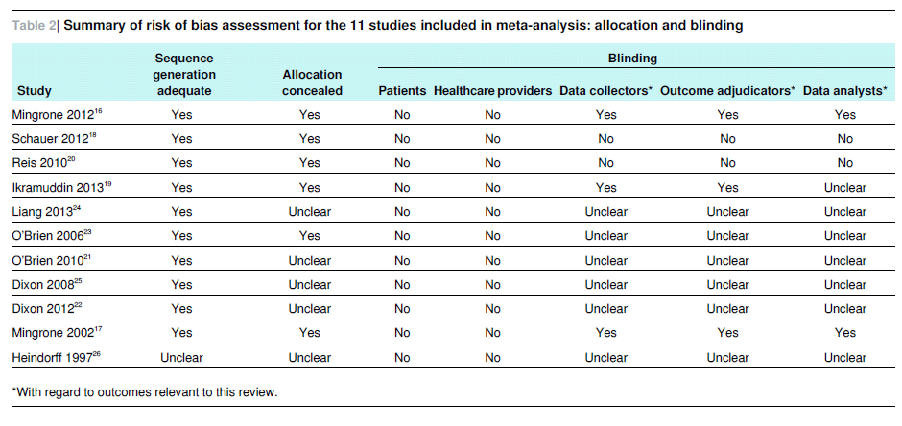
Bariatric surgery versus non-surgical treatment for obesity: a systematic review and meta-analysis of RCT`s
BMJ 2013;347:f5934 doi: 10.1136/bmj.f5934 (Published 22 October 2013)

Slide 34
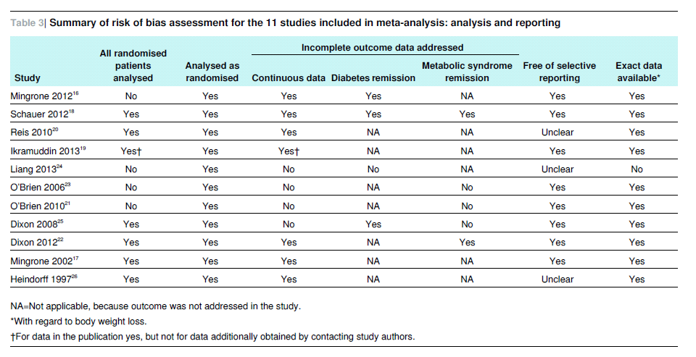
Bariatric surgery versus non-surgical treatment for obesity: a systematic review and meta-analysis of RCT`s
BMJ 2013;347:f5934 doi: 10.1136/bmj.f5934 (Published 22 October 2013)

Slide 35
Bariatric surgery versus non-surgical treatment for obesity: a systematic review and meta-analysis of RCT`s
Strengths and limitations of the metaanalyses
It’s a comprehensive approach to identify all randomised controlled trials comparing bariatric surgery with non-surgical treatment for obesity.
The results proved to be robust across various sensitivity analyses and across most subgroups.
Provides evidence that, compared with non-surgical treatment of obesity, bariatric surgery leads to greater body weight loss and higher remission rates of type 2 diabetes and metabolic syndrome.
The most common adverse events after bariatric surgery were iron deficiency anaemia (malabsorptive bariatric surgery) and reoperations
However, results are limited to two years’ follow-up and based on a small number of studies and individuals.

Slide 36
Bariatric surgery versus non-surgical treatment for obesity: a systematic review and meta-analysis of RCT`s
Strengths and limitations of the metaanalyses (1)
Summary measures of effect sizes are based on only 796 individuals (11 studies or fewer ) depending on outcome.
the methodological quality of five of these studies suffered from unclear allocation concealment
The risk for attrition bias was high in four studies, and attrition was always higher in the non-surgical treatment group.
The results presented in the meta-analysis may not apply to individuals without prior weight loss attempts.

Slide 37
Bariatric surgery versus non-surgical treatment for obesity: a systematic review and meta-analysis of RCT`s
Strengths and limitations of the metaanalyses (2)
All included trials were relatively small, conducted in centres of excellence for bariatric surgery, and limited to a maximum of two years of follow-up.
Underestimation of adverse events in less specialised centres or in larger trials.
Only few studies reported on quality of life, which suggested greater improvements in surgically treated individuals.
The results of this meta-analysis apply only to a population of obese individuals below the age of 60 years with a body mass index ≥30.

Slide 38
Bariatric surgery versus non-surgical treatment for obesity ?
Can we propagate surgery to every hospital and every patient ?
RCT results are not applicable to a broader spectrum
of patients than those defined in the study group
Quality audits on results in real-life settings necessary !
Is quality of surgery guaranteed?
Which patients receive which type of surgery?
Further outcome studies urgently needed !!

Slide 39
Summary and Conclusions
Basic considerations of study designs to demonstrate efficacy and
effectiveness in bariatric surgical research for diabetes
Despite the encouraging results in normal weight or overweight patients with T2DM, surgery can not yet be recommended in these patients
Why?.
Bariatric surgery versus non-surgical treatment for obesity: only 11 RCT`s with 796 individuals published, 7 recruiting
Risk of bias assessments for studies revealed numerous limitations
Conducted in centers of excellence for bariatric surgery, and limited to a maximum of two years of follow-up.
We face a significant efficacy-effectiveness gap
Further high quality multicenter studies are needed
We need a registry for long term survailance

Slide 40
Thanks
My time is over

