Slide 1
Shift of paradigm from Roux-en-Y gastric bypass to loop (mini) gastric bypass because of glucose issues?
Himpens J, Cadière GB
The European School of Laparoscopy
Brussels Belgium

Slide 2
DISCLOSURES of Jacques Himpens
Consultant with Ethicon
Work shop organizer for GORE
Storz technical support

Slide 3

HOW DOES RYGB WORK ON T2DM?

Slide 4
MORBID OBESITY
→ METABOLIC SYNDROME
→ DIABETES II→ INSULIN RESISTANCE (C-peptide )
Morbidly obese patient needs more insulin than non obese in order to maintain eu-glycemic state
When insulin secretion insufficient -> T2DM
(HbA1c>6.0%, which means the patient is mostly hyperglycemic)

Slide 5
INSULIN AND RYGB
Insulin secretion modulated by the incretins
GLP1, PYY, GIP

Slide 6
INSULIN AND RYGB
Insulin secretion modulated by the incretins
GLP1, PYY, GIP
→ Insulin secretion POSSIBLY regulated by
ANTI-INCRETINS produced in duodenum and
proximal jejunum (foregut hypothesis) (Rubino)

Slide 7
INSULIN AND RYGB
Insulin secretion modulated by the incretins
GLP1, PYY, GIP
Insulin secretion POSSIBLY regulated by
ANTI-INCRETINS produced in duodenum and
proximal jejunum (foregut hypothesis) (Rubino)
Insulin secretion triggered by fast delivery of
food stuffs in distal small bowel (hindgut hypothesis)

Slide 8
INSULIN AND RYGB
Insulin secretion POSSIBLY regulated by
ANTI-INCRETINS produced in duodenum and proximal jejunum (foregut hypothesis) (Rubino)
Insulin secretion triggered by fast delivery of food stuffs in distal small bowel (hindgut hypothesis)
After bypass → incretins secretion increased
→ GLP1, PYY, insulin secretion (immediate effect)
→ insulin resistance (weight loss induced)
DISAPPEARS (with time) (Campos, 2010)

Slide 9
INSULIN AND RYGB
Insulin secretion regulated by
ANTI-INCRETINS produced in duodenum and proximal jejunum (foregut hypothesis) (Rubino)
After bypass → incretins secretion increased
→ GLP&, PYY, insulin secretion
After bypass insulin resistance
DISAPPEARS (with time) (Marcos)
→ If sufficient insulin available (beta –cell function),
diabetes remission

Slide 10
INSULIN AND RYGB
Insulin secretion regulated by
ANTI-INCRETINS produced in duodenum and proximal jejunum (foregut hypothesis) (Rubino)
After bypass → incretins secretion increased
→ GLP&, PYY, insulin secretion
After bypass insulin resistance
DISAPPEARS (with time) (Marcos)
→ If sufficient insulin available (beta –cell function),
diabetes remission
Lee WJ et al. Obes Surg. 2012 Feb;22(2):293-8.
C-peptide predicts the remission of type 2 diabetes after bariatric surgery.

Slide 11
INSULIN RESISTANCE
After bypass, and because of previous insulin resistance which is now abolished:
When sugar is taken in orally, relatively too much insulin is produced (pancreatic memory)→ tendency towards hypoglycemia

Slide 12
Patti ME et al. (Harvard) Diabetologia 2010 Nov; 53(11): 2276-9
Hypoglycemia post gastric bypass =
diabetes remission in the extreme

Slide 13
HOWEVER….

Slide 14
DiGiorgi M, et al Columbia University Center
Surg Obes Relat Dis. 2010 May-Jun;6(3):249-53.
Review of 42 RYGB patients with T2DM and >or=3 years of follow-up
T2DM resolved or improved in all patients (64% and 36%, resp.)

Slide 15
DiGiorgi M, et al Columbia University Center
Surg Obes Relat Dis. 2010 May-Jun;6(3):249-53.
Review of 42 RYGB patients with T2DM and >or=3 years of follow-up
T2DM initially resolved or improved in all patients
(64% and 36%, resp.)
24% (10)recurred or worsened after 3 yrs

Slide 16
DiGiorgi M, et al Columbia University Center
Surg Obes Relat Dis. 2010 May-Jun;6(3):249-53.
Review of 42 RYGB patients with T2DM and >or=3 years of follow-up
T2DM resolved or improved in all patients (64% and 36%, resp.)
24% (10)recurred or worsened.
→The patients with recurrence or worsening:
Lower preoperative BMI
More regain of lost weight
Greater weight loss failure rate
Greater postoperative glucose levels

Slide 17
Chikungowo SM et al. Surg Obes Relat Dis. 2010 May-Jun;6(3):254-9.
177 patients with T2DM Roux-en-Y gastric bypass 5-year follow-up.
Early remission of T2DM occurred in 89% of patients

Slide 18
Chikungowo SM et al. Surg Obes Relat Dis. 2010 May-Jun;6(3):254-9.
177 patients with T2DM Roux-en-Y gastric bypass 5-year follow-up.
Early remission of T2DM occurred in 89% of patients
T2DM recurred in 43.1%.
Durable remission correlated most closely with an early disease stage at gastric bypass.

Slide 19
In Practice…

Slide 20
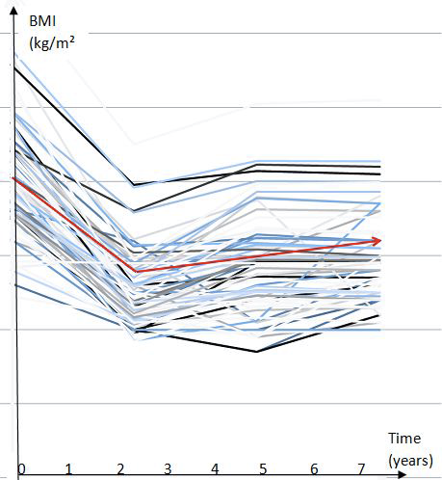

LRYGB at long-term (>6 years): BMI
Obes Surg 2012;22(10)

Slide 21
LRYGB at long-term (>6 years):T2DM
Type 2 Diabetes (T2DM): incidence at 0 years
T2DM
Normoglycemia
N=77
Obes Surg 2012:22(10)

Slide 22
LRYGB at long-term (>6 years):
Type 2 Diabetes (T2DM): incidence at 9 years
New onset
T2DM
Normoglycemia
Hypoglycemia
N=77
Obes Surg 2012:22(10)

Slide 23
HOW TO EXPLAIN THIS CONDITION ?

Slide 24
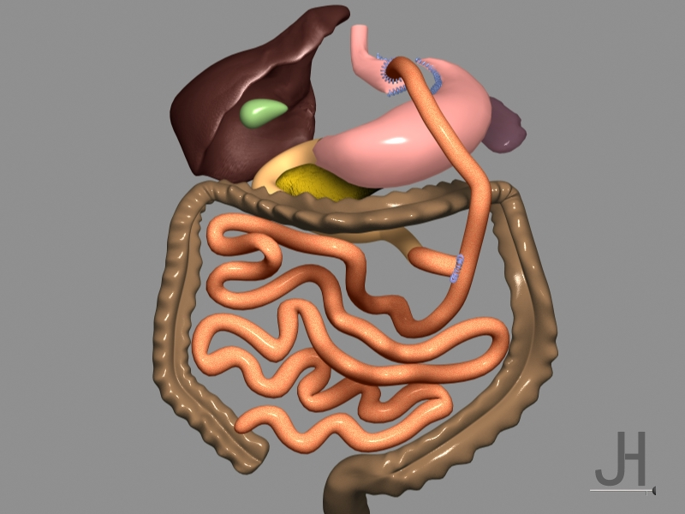
Absorption
and breakdown of sugars,
NOT of fat

Slide 25
Absorption
and breakdown of sugars,
NOT of fat
TRIGGER OF INCRETIN SECRETION???

Slide 26
Absorption
and breakdown of sugars,
NOT of fat: BILE SALTS
IMBALANCE (Leroux)

Slide 27
Absorption
and breakdown of sugars,
NOT of fat: BILE SALTS
IMBALANCE (Leroux)
Fat absorption
(bile salts)

Slide 28

Absorption
and breakdown of sugars,
NOT of fat: BILE SALTS
IMBALANCE (Leroux)
Fat absorption
(bile salts): TRIGGER
OF INCRETIN SECRETION?

Slide 29
HOW MAY WE AVOID THE BILE ACID IMBALANCE?

Slide 30
TO AVOID BILE SALTS IMBALANCE IN RYGB IT MIGHT BE INDICATED TO MAKE ALIMENTARY LIMB AS SHORT AS POSSIBLE

Slide 31
STOMACH POUCH
ANASTOMOSIS
SCHEMATIC OF A
ROUX-EN-Y BYPASS
ALIMENTARY
LIMB (Jejunum)
NO BILE!
COMMON LIMB
BILIARY
LIMB

Slide 32
THE “NEW” BYPASS
STOMACH POUCH
ANASTOMOSIS
ALIMENTARY
LIMB NO BILE!
BILIARY
LIMB

Slide 33
THE “NEW” BYPASS
STOMACH POUCH
ANASTOMOSIS
ALIMENTARY
LIMB NO BILE!
ALIMENTARY LIMB
REDUCED TO ZERO
BILIARY
LIMB

Slide 34
THE “NEW” BYPASS
STOMACH POUCH
BILIARY
LIMB
COMMON LIMB
ALIMENTARY LIMB
REDUCED TO ZERO:
Mix of food stuffs with bile!

Slide 35
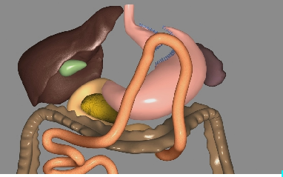
THE “NEW” BYPASS

Slide 36
CLINICAL EXAMPLE

Slide 37
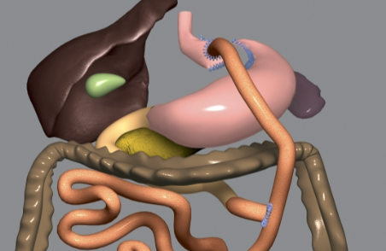
Mg/dl
Progression of plasma glucose after oral glucose challenge
Of 50 grams, RYGB 2001
Female, 63 years, BMI= 22 kg/m², non-diabetic

Slide 38
RYGB vs Gastrostomy
Mg/dl
Mc Laughlin T et al.
J Clin Metab 2010;95(4)
Progression of plasma glucose after oral glucose challenge
Of 50 grams. Control = gastrostomy (2011)
Female, 63 years, BMI= 22 kg/m², non-diabetic

Slide 39
Gastrostomy vs Minibypass
Mg/dl
Progression of plasma glucose after oral glucose challenge
Of 50 grams. Control = gastrostomy (2011)
Female, 63 years, BMI= 22 kg/m², non-diabetic

Slide 40

RYGB vs Gastrostomy vs Minibypass
Mg/dl
Progression of plasma glucose after oral glucose challenge
Of 50 grams. Control = gastrostomy
Comparison of status with RYGB vs MGB
Female, 63 years, BMI= 22 kg/m², non-diabetic

Slide 41
RYGB vs Gastrostomy vs Minibypass
HOWEVER, IN AN ONGOING STUDY COMPARING RYGB VERSUS MINIGB
(NON BIABETIC PATIENTS, 3 YEARS POSTOP)VERSUS CONTROLS
WE WERE NOT ABLE TO REPRODUCE THESE FINDINGS.
IN FACT, THE GLUCOSE PROGRESSION AFTER OGTT APPEARS TO BE IDENTICAL FOR
BOTH PROCEDURES

Slide 42
Lee WJ et al.
Obes Surg. 2012 Dec;22(12):1827-34.
Laparoscopic Roux-en-Y versus mini-gastric bypass for the treatment of morbid obesity: a 10-year experience.
LMGBP can be regarded as a simpler and safer alternative to LRYGB with similar efficacy at a 10-year experience.

Slide 43
Lee WJ,et al
Arch Surg. 2011 Feb;146(2):143-8
Gastric bypass vs sleeve gastrectomy for type 2 diabetes mellitus: a randomized controlled trial.
Patients after MINI gastric bypass were more likely to achieve remission of T2DM than after sleeve

Slide 44
CONCLUSIONS:
-While effective for glucose control, RYGB will not prevent recurrent/ de novo T2DM in a number of patients
-T2DM recurrence after RYGB is NOT directly linked with weight regain

Slide 45
CONCLUSIONS:
-While effective for glucose control, RYGB will not prevent recurrence of T2DM or de novo appearance of T2DM in a number of patients

Slide 46
CONCLUSIONS:
-While effective for glucose control, RYGB will not prevent recurrence of T2DM in a number of patients
-T2DM recurrence after RYGB is NOT directly linked with weight regain
-T2DM recurrence = pancreas β cell exhaustion?

Slide 47
CONCLUSIONS:
-While effective for glucose control, RYGB will not prevent recurrence of T2DM in a number of patients
-T2DM recurrence after RYGB is NOT directly linked with weight regain
-T2DM recurrence = pancreas exhaustion?
-Can the Mini bypass prevent β cell exhaustion?

Slide 48

PARADIGM SHIFT AWAY FROM RYGB AND LAGB?
Evolution in the world of relative frequency of LRYGB, LSG and LAGB
(in % of total procedures)
Buchwald H, Oien DM Obes Surg 2013 Jan 22

Slide 49
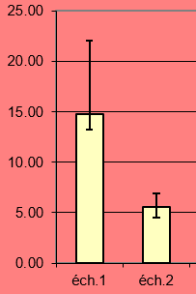
FASTING INSULIN PRE- VERSUS POST OLGB
Fasting Plasma insulin in non-diabetic patients submitted to OLGB
-preoperative: éch1 (median + IQR) → BMI 39.9 (2.5)
-3 years postoperative: éch2 (mean + SD) → BMI 24.5 (3.2)
Consecutive patients, N=14
Vertical axis: µU/ml
P<0.001, Wilcoxon
Validated Qtest Dixon

Slide 50
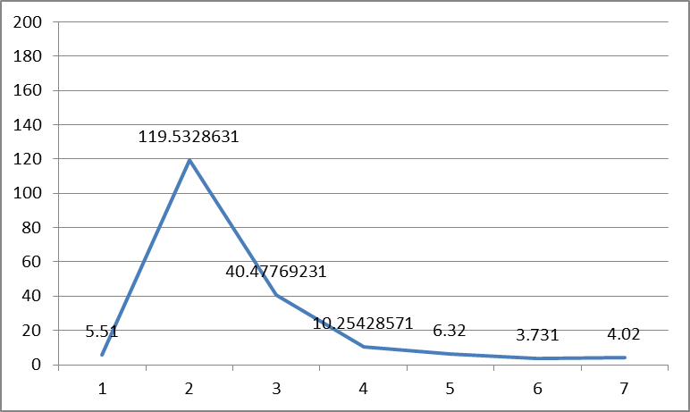
PLASMA INSULIN DURING OGTT 3 YEARS AFTER OLGB
Progression of plasma insulin during OGTT (50 grams of glucose). Values in µu/ml. Values are mean + SD when normally distributed or median + interquartile range when not normally distributed despiteDixon’s correction
Time point 1= 0, 2=30’, 3=60’, 4=90’,5=120;, 6= 180’, 7= 240’

Slide 51
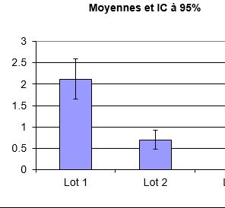
HOMA
MEAN + STANDARD DEVIATION
HOMA-IR BEFORE (lot 1) and 3 YEARS
AFTER OLGB. Student TTEST p<0.001
N=14

Slide 53
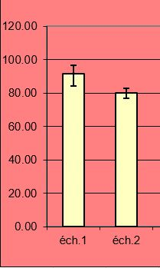
MEDIAN + IQR
FASTING PLASMA GLUCOSE (mg/dl) BEFORE (éch1) AND
(éch2), 3 YEARS AFTER OLGB
P<0.001, Wilcoxon.

Slide 54
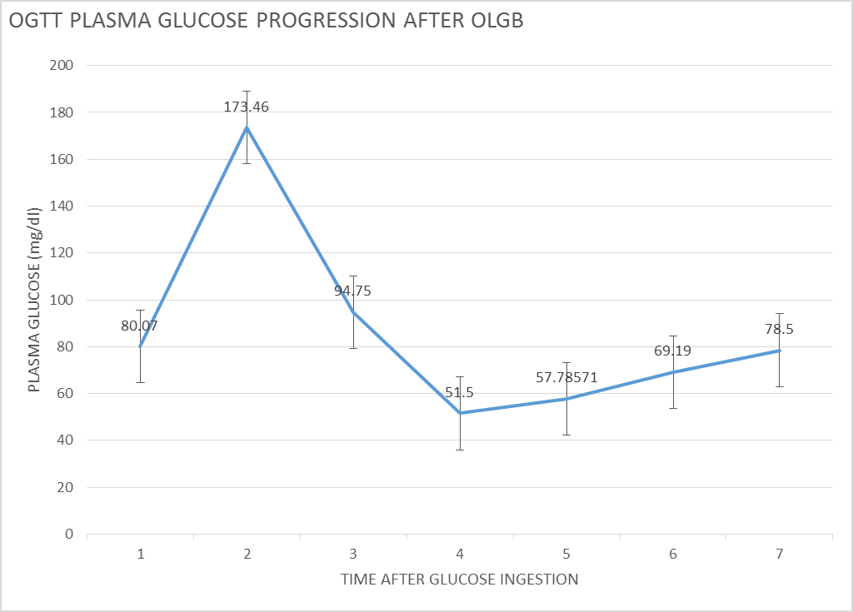

Slide 55
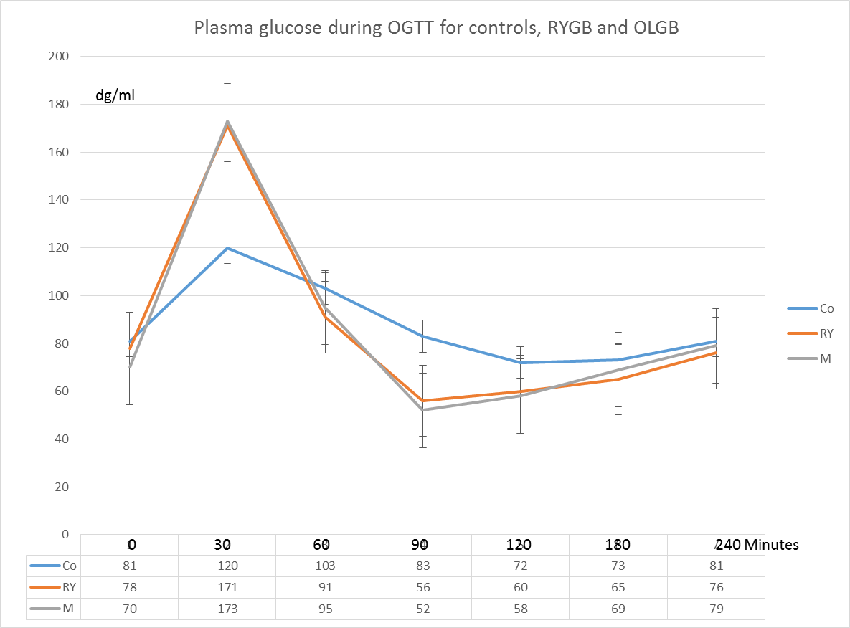

Slide 56
AT OGTT, PERFORMED WITH 50 GR OF GLUCOSE,
58% OF OLGB PATIENTS
50% OF RYGB PATIENTS
7% OF CONTROL PATIENTS p<0.05
DEVELOPED HYPOGLYCEMIA (<50 mg/dl)
Ns (Z-test

Slide 57
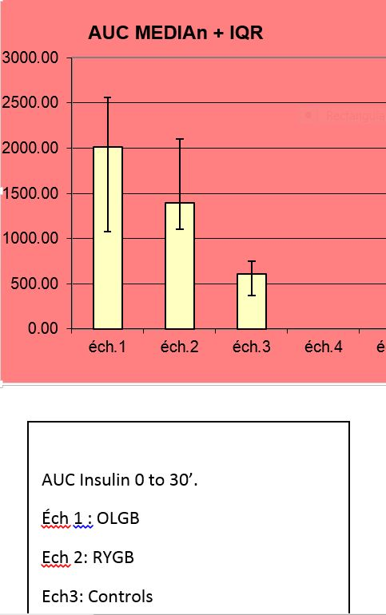
ANOVA + TUKEY TEST
ns
P<0.05
N=14 IN EACH GROUP

Slide 58
WITH THE OGTT TEST NO DIFFERENCE BETWEEN OLGB AND RYGB

Slide 59
WITH THE OGTT TEST NO DIFFERENCE BETWEEN OLGB AND RYGB
→ NO CLINICAL SIGNS OF NEUROGLYCOPENIA

Slide 60
WITH THE OGTT TEST NO DIFFERENCE BETWEEN OLGB AND RYGB
NO CLINICAL SIGNS OF NEUROGLYCOPENIA
RYGB HAD BEEN PERFORMED WITH BILIARY LIMB OF 150 CM AND ALIMENTARY OF 60 CM,
A CONSTRUCTION THAT RESEMBLES THE OLGB

Slide 61
WITH THE OGTT TEST NO DIFFERENCE BETWEEN OLGB AND RYGB
NO CLINICAL SIGNS OF NEUROGLYCOPENIA
RYGB HAD BEEN PERFORMED WITH BILIARY LIMB OF 150 CM AND ALIMENTARY OF 60 CM,
A CONSTRUCTION THAT RESEMBLES THE OLGB
→ STUDY SHOULD BE REPEATED WITH A “CONVENTIONAL” RYGB

